Slide 1



Building Successful
AI Agents

Slide 2
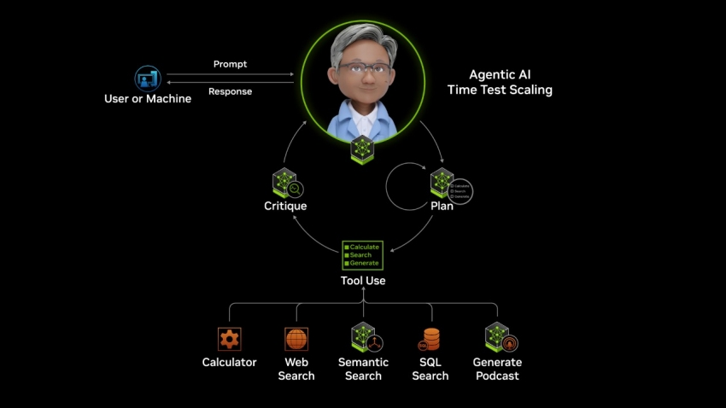
AI Agents can use multiple LLM models, tools, and functions to get complex tasks done
https://www.nvidia.com/en-us/glossary/ai-agents/

Slide 3
Design
Evaluation
Observability
Monitoring
Analytics
Audit

Slide 4

Design
Define goal, success criteria and constraints
Decide tools, escalation rules, autonomy level
Build prompts, choose task specific LLMs, put guardrails, etc.
Evaluation
Observability
Monitoring
Analytics
Audit

Slide 5
new
Design
Humans need to learn how to test probabilistic AI systems
Evaluation
Evals: Then most important & time consuming
Humans need to create a Golden Dataset
Is the AI Agent doing the right thing?
Check for task success, tool correctness, plan correctness, safety, quality
Decide on evaluation metrics
Human are very involved but also automate
Observability
Monitoring
Analytics
Audit

Slide 6
new
Design
Evaluation
Humans manage a Digital Workforce
Observability
Goal: (In Production): Humans observe & spot check the Agents reasoning & results
Humans need to create a Golden Dataset
Is the AI Agent doing the right thing?
Check for task success, tool correctness, plan correctness, safety, quality
Decide on evaluation metrics
Human are very involved but also automate
Monitoring
Analytics
Audit

Slide 7
Design
Evaluation
Observability
Monitoring
Goal: (In Production): Is something going wrong right now?
Realtime Alerts for errors, failures, threshold violation, scope drifts, etc.
Dashboard which are operation focused
Analytics
Audit

Slide 8
Design
Evaluation
Observability
Monitoring detects failure
Observability explains it
Monitoring
Analytics
Audit

Slide 9
Design
Evaluation
Observability
Monitoring
Analytics
Goal: What patterns are emerging overtime
Trends, bottlenecks, costs, latency
User behavior , Agent behavior and efficiency
Business insights
Audit

Slide 10
Design
Evaluation
Observability
Monitoring
Analytics
Audit
Goal: What happened two years ago? Prove it
For compliance & forensics
Critical for regulated industries
Immutable logs capturing agentic digital footprint

Slide 11
Design
Evaluation
Observability
Continuous Optimization
Monitoring
Analytics
Audit

Slide 13
Design
Evaluation
Evals: Then most important & time consuming
Humans need to create a Golden Dataset
Is the AI Agent doing the right thing? Test against expected outcomes?
Check for task success, tool correctness, plan correctness, safety, quality
Decide on evaluation metrics
Human are involved but also automate
Observability
Monitoring
Analytics
Audit

Slide 14
Design
Define goal, success criteria, constraints, tools, escalation rules
Prompt, policy, workflow, autonomy level
Evaluation
Observability
Monitoring
Analytics
Audit

Slide 15
Design
Evaluation
Observability
Monitoring
Analytics
Analytics

Slide 16
Design
Evaluation
Observability
Monitoring
Analytics
Analytics

Slide 17
AI Agents can make decisions; take actions and can be autonomous or semi-autonomous

Slide 18

What are Evaluations (evals) ?
evals test AI Agents to ensure it is performing against your expectations in a safe manner.
Reliability
Accuracy
Latency
Cost

Slide 19
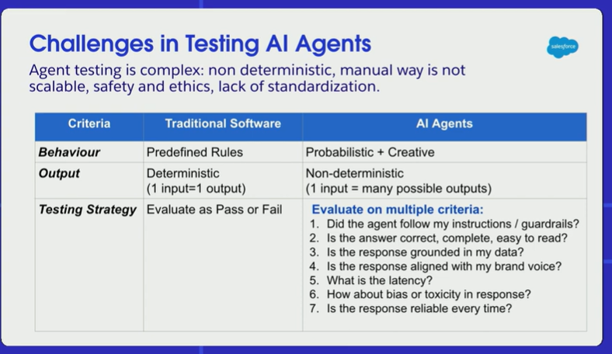
https://www.youtube.com/watch?v=ZR6YEL5k7CY&t=928s

Slide 20
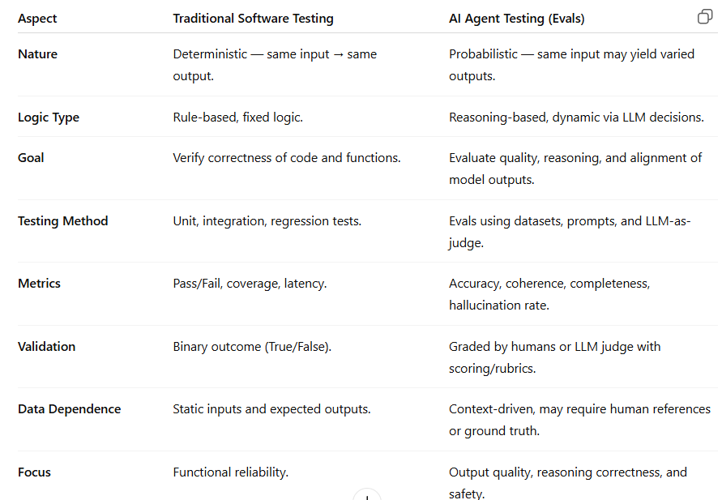

Slide 21
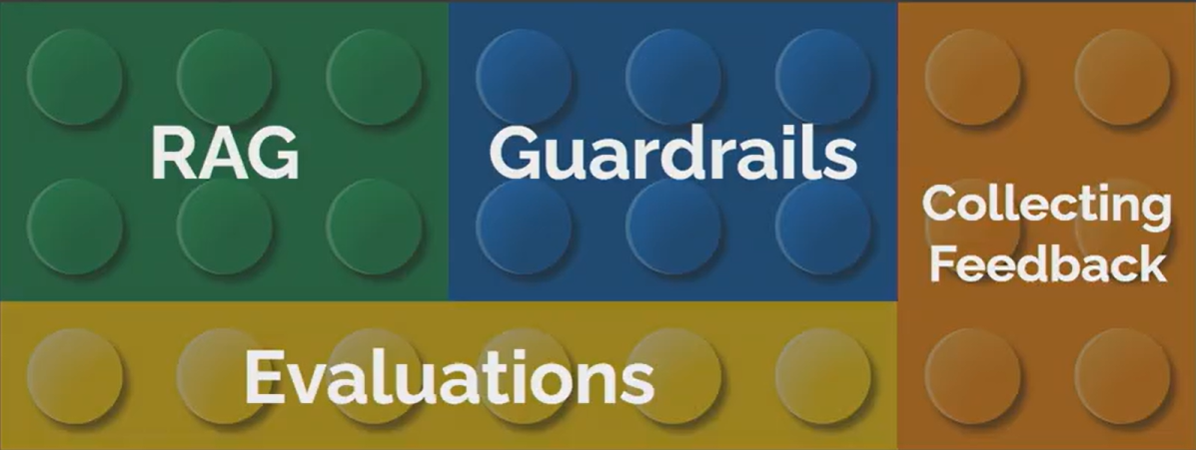

Foundations of building AI Systems
Source: https://www.youtube.com/watch?v=LzeC1AQ-U5o

Slide 22

Evaluation Methods
Human evaluation
LLM as a Judge
Heuristics
Dataset
Ground truth
Synthetic data
Audit logs
User feedback (for continuous improvement)
Eval Scores
AI System
(AI Agent , LLM App or RAG Agent)
Relevance, Accuracy, Coherence, Fluency or custom score

Slide 23

Dataset
Ground truth (golden dataset)
Synthetic data
Audit logs
User feedback (for continuous improvement)
Input
Expected Output
Input
Expected Output
Input
Expected Output

Slide 24

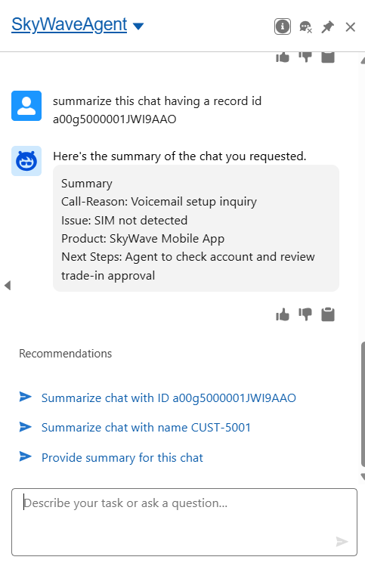
LLM as a Judge
Heuristics
User Feedback
Another AI Model scores outputs
> Rule based checks for quality
> Ex Status can be Open/Pending/Re-Issue/Closed

Slide 25
LLM as a Judge
LLM-as-a-Judge uses a smarter AI to grade another AI’s answers based on rules you care about. It gives quick, consistent scores for things like relevance, accuracy, clarity, and custom scores you care about.
Input
Expected Output
Input
Expected Output
Eval Scores
Input
Expected Output
LLM as a Judge
Relevance, Accuracy, Coherence, Fluency or custom score
Agent Output
Agent Output
Agent Output

Slide 26
Heuristics
Keyword match check:
Missing key terms: customer name, or issue type?
Length check:
Is response too long or short
Format check:
Is output structure correct
Completeness rule:
Are all required fields (like status, reason, action) filled in?
Status logic check:
If issue is Closed, no Next Steps should remain open.

Slide 27
Evaluation Methods
Human evaluation
LLM as a Judge
Heuristics
Dataset
Ground truth
Synthetic data
Audit logs
User feedback (for continuous improvement)
Eval Scores
AI System
(AI Agent , LLM App or RAG Agent)
Relevance, Accuracy, Coherence, Fluency or custom score

Slide 28
Human Evaluation
Typically used in early stages to set benchmarks and guide automated evaluation setup
Humans manually review outputs for correctness, clarity, and relevance
Useful when judgment or nuance is needed
(e.g., tone, empathy, reasoning quality)

Slide 29
Run evaluations, make changes to your
AI Agents to meet your expectations.
Refine prompts
Tune parameters
Improve grounding
Experiment with different LLMs
Adjust function or tool calls
Fine-tune

Slide 30
Observability: Monitor & understanding how your AI Agent behaves in real time
Track metrics — latency, accuracy, failure rates.
Log interactions — prompts, responses, tool calls.
Monitor drift — detect changes in quality over time.
Visualize trends — use dashboards for quick insights.
Enable alerts — catch anomalies or performance drops early.
Continuously optimize — use insights to refine prompts, models, and data

Slide 31
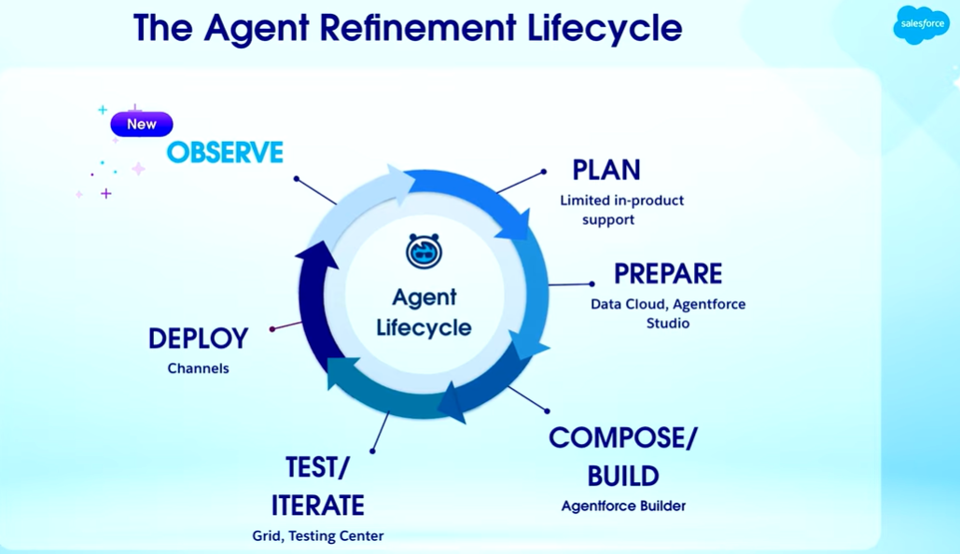
https://www.youtube.com/watch?v=ZR6YEL5k7CY&t=928s

Slide 32

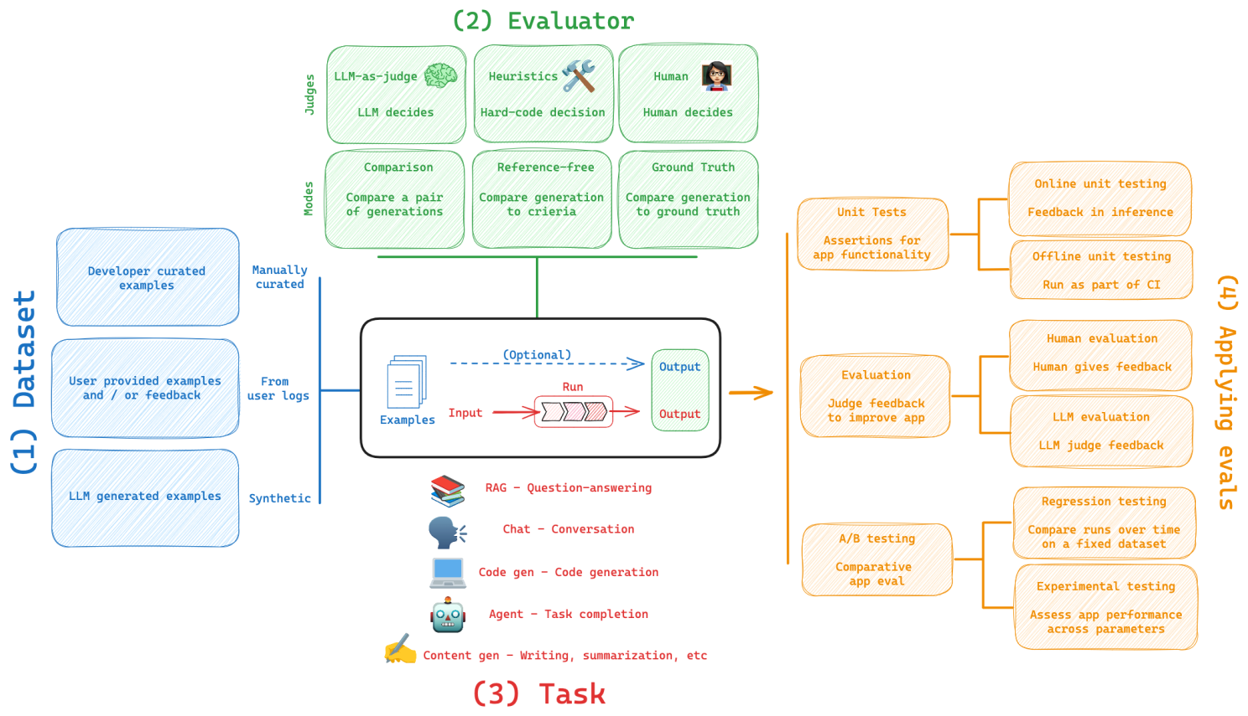
LangSmith Evals Framework

