Slide 1
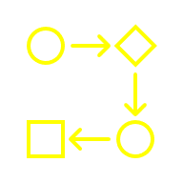

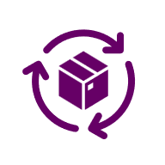
Distillation
Fine Tuning
AI Mindset

Slide 2

Most teams treat LLMs like a one-size-fits all solution.
They use a frontier model like (OpenAI GPT 5.2 or Claude 3.5) for every task.
This is like hiring a PhD to do data entry work.

Slide 3
Most teams treat LLMs like a one-size-fits all solution.
They use a frontier model like (OpenAI GPT 5.2 or Claude 3.5) for every task. This is like hiring a PhD to do data entry work.
Exploding costs
Latency bottlenecks
Vendor lock-in
AI Cost TOO High
AI projects are time consuming
AI project disappointment
AI is not 100% accurate
AI is slow

Slide 4
Teams need to have a mindset to use Task specific models
1
Match model size to task complexity
Task Type | Intelligence Needed | Model
Text classification | Low | SLM
Data extraction | Low-medium | SLM
Summarization | Medium | Mid-size LLM
Multi-modal reasoning | High | LLM
Reasoning & Planning | High | LLM
PDF Reading | Medium-High | Use Model specialized in PDF reading
Evaluation | Medium | Mid-size or topic specific expert model

Slide 5
2
Get familiar with SLM (small Language models)
Use Small Language Models first. Move up if needed.
Smaller, faster, cheaper models
Optimized for specific tasks
Often 10–20x cheaper per request
Task like these do not need frontier models
Classification (intent, sentiment, routing)
Entity extraction
Structured data generation
Simple summaries
Tool selection inside agents

Slide 6

2
Small Language Models are lightweight versions of LLMs
LLM
Gemini, GPT 4
SLM
Phi, Gemma
Focused Expert
Task Specific
1B – 10B parameters
General Genius
Multi-modal
70B +

Slide 7
2
Benefits of Small Language Models
Cost Efficiency
Require less compute & are cheaper to run
Data Privacy
Can be deployed on-premise, ensuring compliance & security
Low Latency
Faster inference due to small size
Deployment Flexibility
Many can run on-device, at the edge, or offline
Avoid Vendor Lock In
Avoid reliance of costly API vendors
Accuracy for task
With fine tuning SLMs can perform as-good or even better than LLMs

Slide 8
Distillation fine-tuning is a technique where a smaller model learns to mimic a larger model on a specific task.

Slide 9
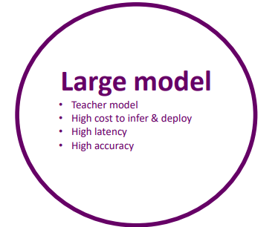
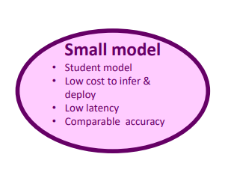
Distillation
A smaller model learns to mimic a larger model on a specific task
Deploy models on the edge
Large Model generated Data
Input
Output
Input
Output
Input
Output
Input
Output
Input
Output
Teach a smaller model to behave like a larger model on a specific task
Step 1: The large, high-performing Teacher Model generates responses to a wide range of prompts.
Step 2: A smaller Student Model is trained to mimic those responses, achieving similar quality with faster and lighter performance.

Slide 10

Supervised Fine-Tuning
Model learns new domain or task specific behavior
Classification, structured extraction, formatting
Reduce cost by replacing long prompts
Preference Alignment (RLHF / DPO)
Direct Preference Optimization (DPO)
Learns human like preferences
Align chatbot to brand tone
Optimize a model to favor certain output over others
Kind of subjective alignment
RLHF (Reinforcement Learning with Human Feedback)
Teach a model nuanced & complex human preferences
Ex Multi-turn reasoning
Medical, Legal etc.
Distillation
A smaller model learns to mimic a larger model
Deploy models on the edge

Slide 11

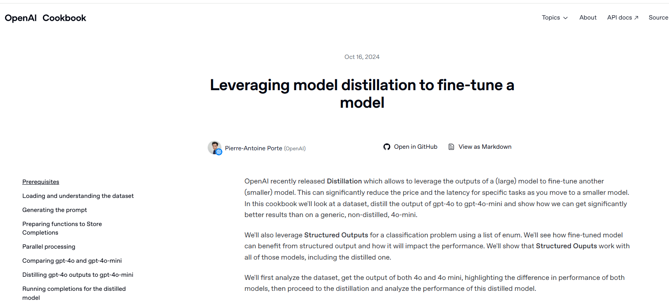

example
Classifying grape variety from wine reviews
https://cookbook.openai.com/examples/leveraging_model_distillation_to_fine-tune_a_model

Slide 12
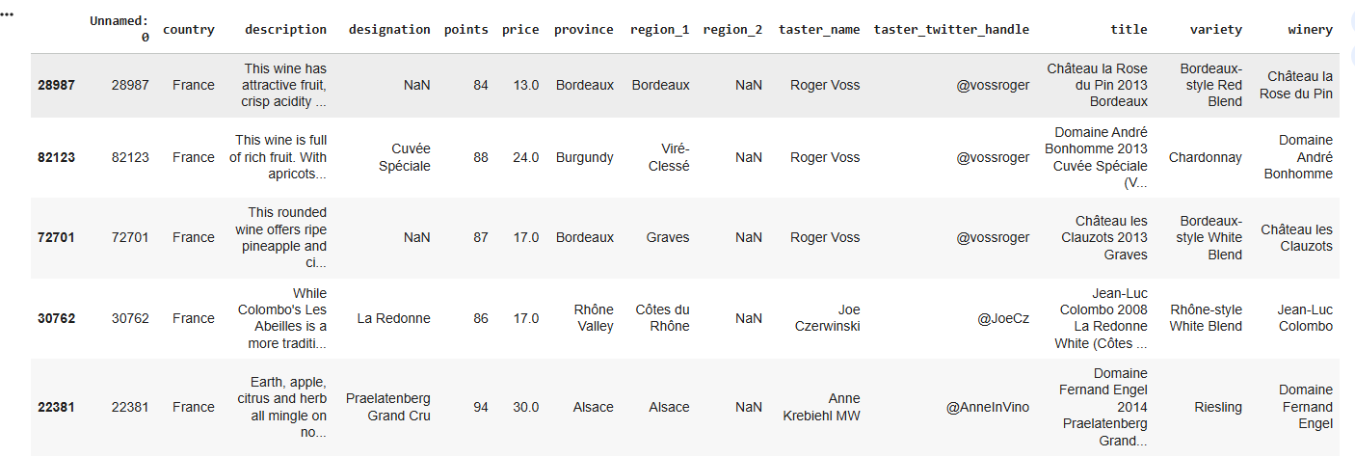
example
Use case: Classifying grape variety from wine reviews
https://cookbook.openai.com/examples/leveraging_model_distillation_to_fine-tune_a_model

Slide 13
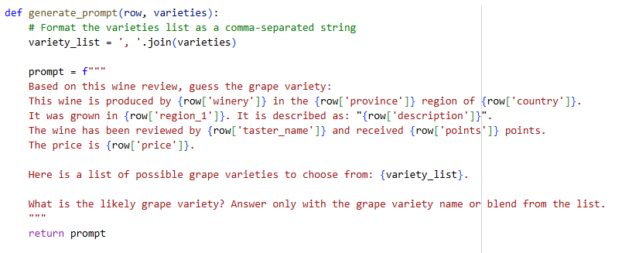

example
Synthetic data sample used for Distillation Finetuning
Input
Output
https://cookbook.openai.com/examples/leveraging_model_distillation_to_fine-tune_a_model

Slide 14
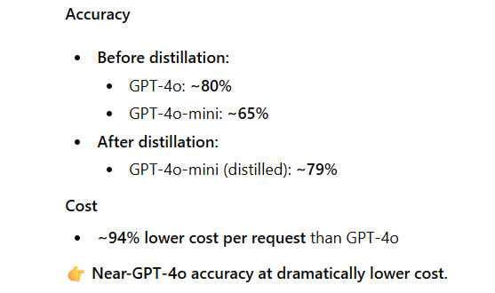
Outcome of using a smaller model trained using distillation technique : 94% lower cost

Slide 15
Appendix

Slide 16
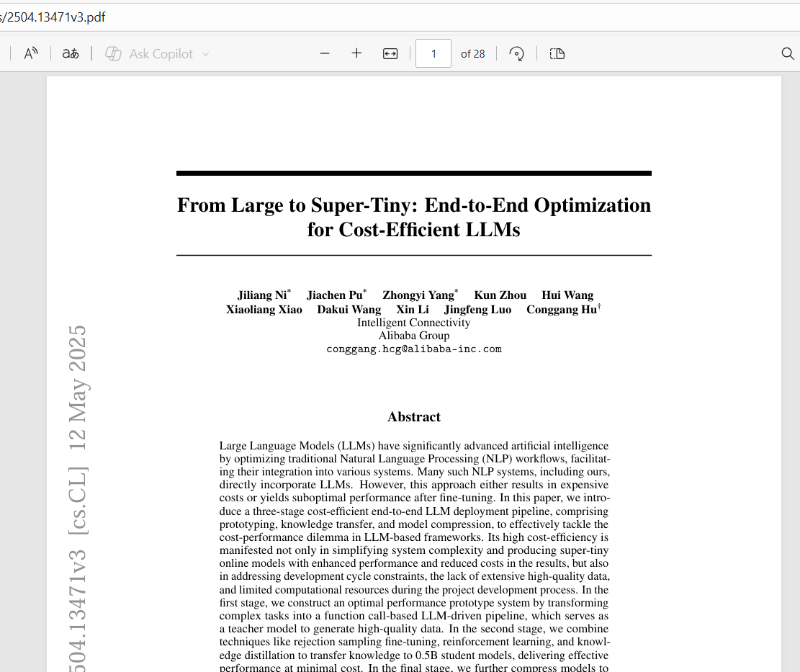
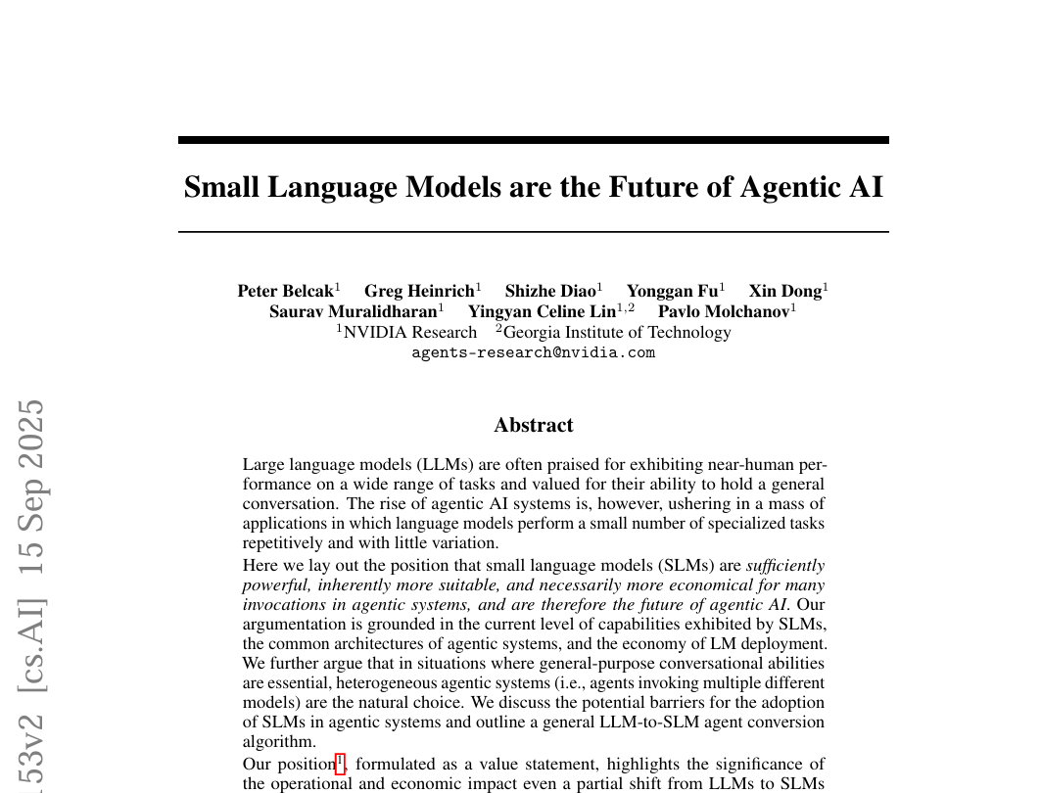
Reference: I encourage you to read these papers

