Slide 1



Eval
Fundamentals

Slide 2
AI Agents can make decisions; take actions and can be autonomous or semi-autonomous

Slide 3
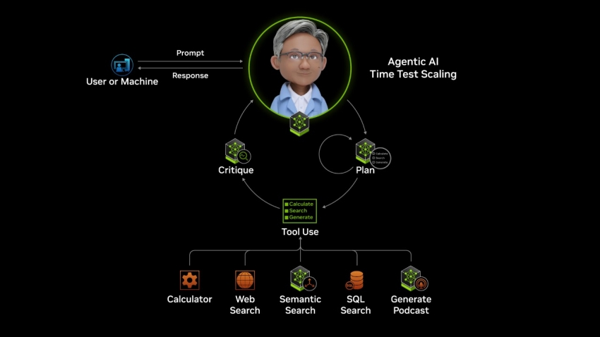
AI Agents can use multiple LLM models, tools, and functions to get complex tasks done
https://www.nvidia.com/en-us/glossary/ai-agents/

Slide 4

What are Evaluations (evals) ?
evals test AI Agents to ensure it is performing against your expectations in a safe manner.
Reliability
Accuracy
Latency
Cost

Slide 5
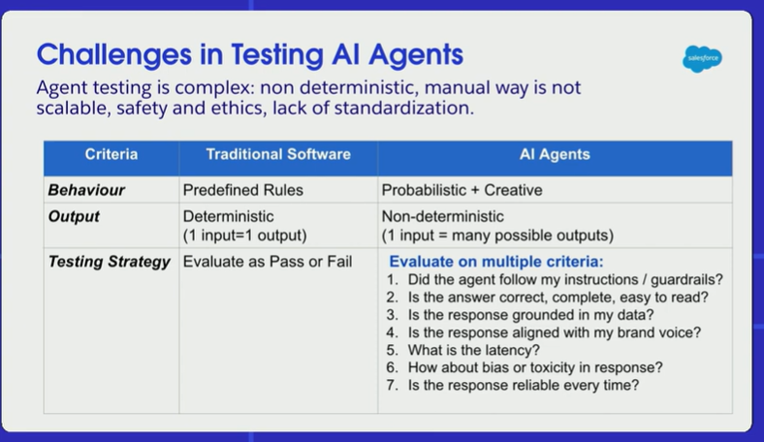
https://www.youtube.com/watch?v=ZR6YEL5k7CY&t=928s

Slide 6
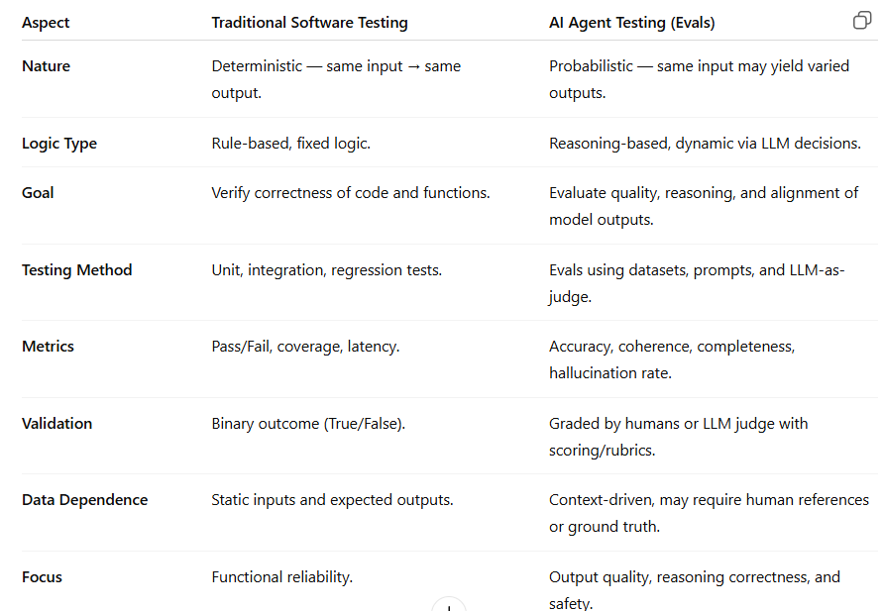

Slide 7
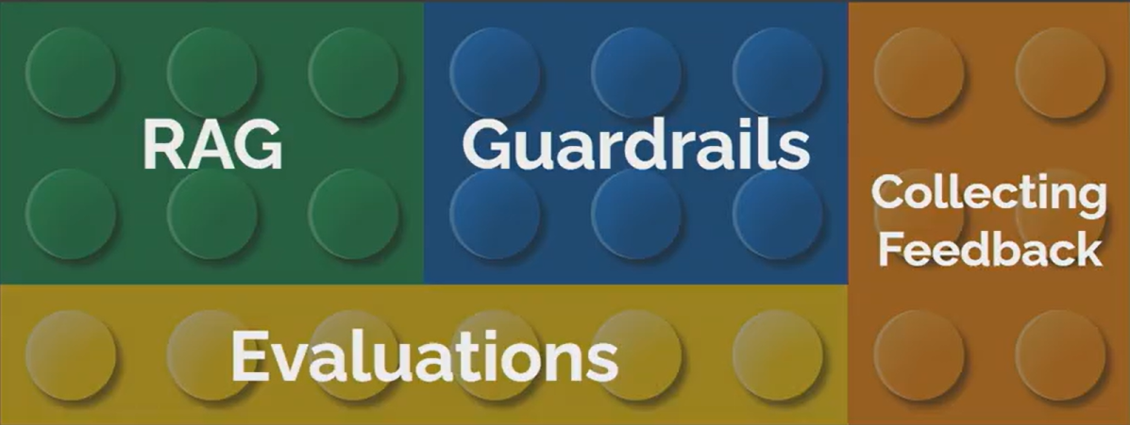

Foundations of building AI Systems
Source: https://www.youtube.com/watch?v=LzeC1AQ-U5o

Slide 8

Evaluation Methods
Human evaluation
LLM as a Judge
Heuristics
Dataset
Ground truth
Synthetic data
Audit logs
User feedback (for continuous improvement)
Eval Scores
AI System
(AI Agent , LLM App or RAG Agent)
Relevance, Accuracy, Coherence, Fluency or custom score

Slide 9

Dataset
Ground truth (golden dataset)
Synthetic data
Audit logs
User feedback (for continuous improvement)
Input
Expected Output
Input
Expected Output
Input
Expected Output

Slide 10

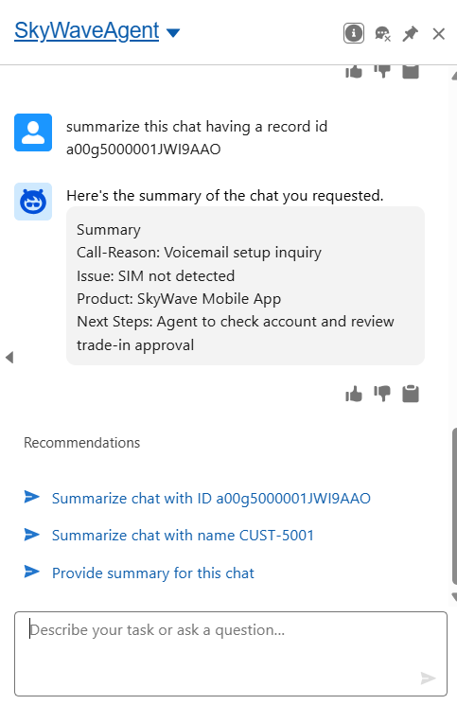
LLM as a Judge
Heuristics
User Feedback
Another AI Model scores outputs
> Rule based checks for quality
> Ex Status can be Open/Pending/Re-Issue/Closed

Slide 11
LLM as a Judge
LLM-as-a-Judge uses a smarter AI to grade another AI’s answers based on rules you care about. It gives quick, consistent scores for things like relevance, accuracy, clarity, and custom scores you care about.
Input
Expected Output
Input
Expected Output
Eval Scores
Input
Expected Output
LLM as a Judge
Relevance, Accuracy, Coherence, Fluency or custom score
Agent Output
Agent Output
Agent Output

Slide 12
Heuristics
Keyword match check:
Missing key terms: customer name, or issue type?
Length check:
Is response too long or short
Format check:
Is output structure correct
Completeness rule:
Are all required fields (like status, reason, action) filled in?
Status logic check:
If issue is Closed, no Next Steps should remain open.

Slide 13
Evaluation Methods
Human evaluation
LLM as a Judge
Heuristics
Dataset
Ground truth
Synthetic data
Audit logs
User feedback (for continuous improvement)
Eval Scores
AI System
(AI Agent , LLM App or RAG Agent)
Relevance, Accuracy, Coherence, Fluency or custom score

Slide 14
Human Evaluation
Typically used in early stages to set benchmarks and guide automated evaluation setup
Humans manually review outputs for correctness, clarity, and relevance
Useful when judgment or nuance is needed
(e.g., tone, empathy, reasoning quality)

Slide 15
Run evaluations, make changes to your
AI Agents to meet your expectations.
Refine prompts
Tune parameters
Improve grounding
Experiment with different LLMs
Adjust function or tool calls
Fine-tune

Slide 16
Observability: Monitor & understanding how your AI Agent behaves in real time
Track metrics — latency, accuracy, failure rates.
Log interactions — prompts, responses, tool calls.
Monitor drift — detect changes in quality over time.
Visualize trends — use dashboards for quick insights.
Enable alerts — catch anomalies or performance drops early.
Continuously optimize — use insights to refine prompts, models, and data

Slide 17
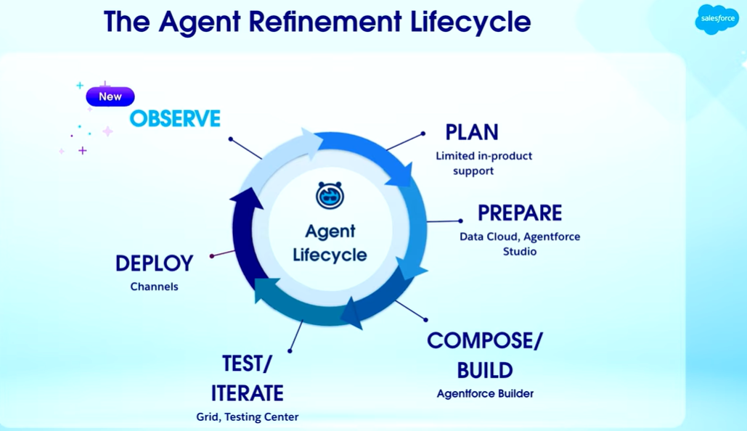
https://www.youtube.com/watch?v=ZR6YEL5k7CY&t=928s

Slide 18

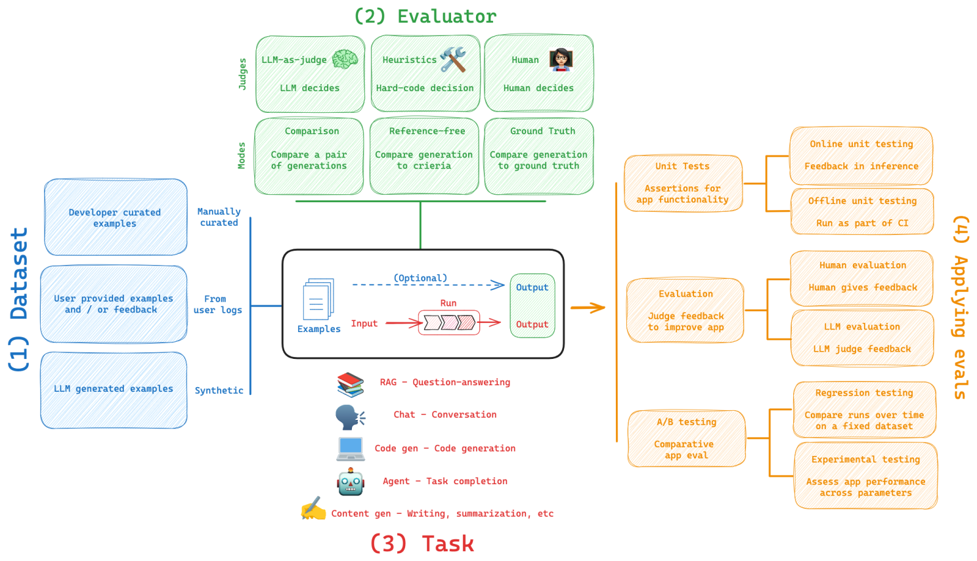
LangSmith Evals Framework

