Slide 1



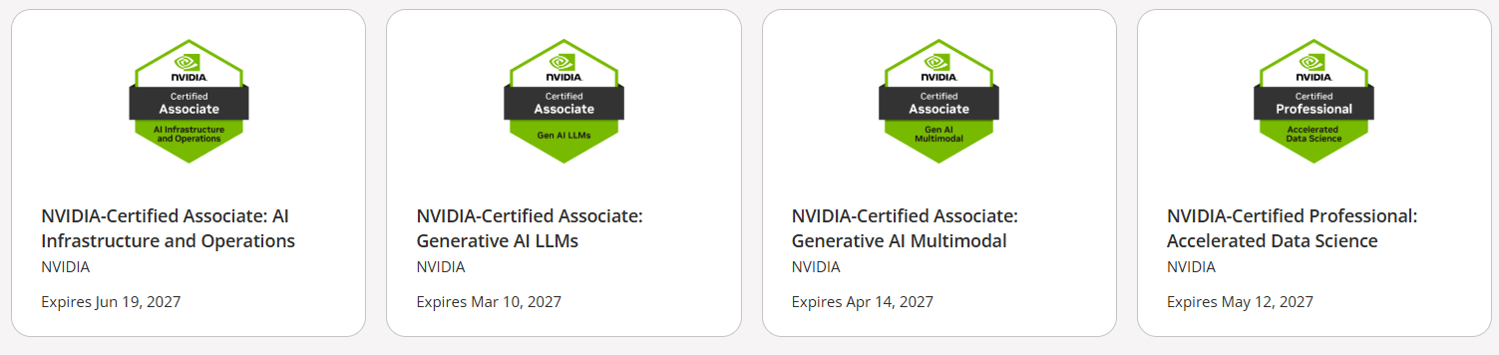

Evals for
GenAI Apps
Eval Scores
Relevance, Accuracy , Coherence, Fluency and custom scores
Sandeep Arora
www.trilyen.com

Slide 2
LLM Evaluation
GenAI applications (AI Apps) inherently carry some risk as LLM models are known to hallucinate.
This slows the development & adoption of AI apps.
Evaluations (often called Evals) are methods designed to assess the performance, quality and capabilities of AI applications.
High quality evals provide confidence to companies and teams to adopt AI apps
Evals can be used to evaluate both AI Apps which may use multiple LLMs, or the model itself
Evals
Provide a framework for evaluating AI Systems or LLMs by ensuring that the results generated by the AI App meets or exceeds the accuracy criteria that is important for your use case.

Slide 3
Evals for AI Apps
Before you start , have a solid understanding of the objectives of your Eval
Discuss with your team and answer the following questions
The answer to these will help in your evaluation process
Eval Scores
What is my objective
What am I evaluating? What evals are the most important
How will I create my dataset
What kind of output do I want my AI App to generate
How can I tell if output is correct
What is my accuracy tolerance level
What kind of inputs should my AI App be able to handle
What can my AI App do or cannot do
Relevance, Groundedness, Coherence, Fluency or custom

Slide 4

Evaluation Metrics for your GenAI App or AI Agent
Below are certain common eval criteria for AI Apps. The criteria you decide to score on will also depend on your use case.
Groundedness (Accuracy)
Does the model's generated answers align with information from the source data (Context or RAG pattern)
Relevance
Is the model's generated response relevant & directly related to the given questions.
Custom Evals
Based on your use case
Coherence
Measures how well the LLM generates content that is natural & resembles human-like language.
Fluency
Measures the grammatical correctness of the generative content. (Useful in domains product description generation, marketing, etc.)
Some common Eval scores to consider

Slide 5
For your use case > define evaluation metrics
Prepare your evaluation dataset
Decide on evaluation methods (Human evaluation, LLM-as-a-Judge, Heuristics )
Run an evaluation
Analyze your evaluation results and optimize AI system till eval metrics match your goals
Evaluation Process
Evaluation Methods
Human evaluation
LLM as a Judge
Heuristics
Eval Metrics
Dataset
Ground truth
Synthetic data
User feedback (for continuous improvement)
AI System
(LLM , AI System or RAG)
Eval Scores
Relevance, Groundedness, Coherence, Fluency or custom
Input
Output
Input
Output
Input
Output
Input
Output
Input
Output

Slide 6

Run Evaluation, Analyze and Optimize
Run Predictions: Feed inputs from the golden dataset into the AI app and collect its outputs.
Compare Results:
  Use a larger LLM-as-a-judge to evaluate and score the outputs.
  Conduct human evaluation for subjective aspects like clarity, tone, and usefulness.
Analyze Failures: Review low-scoring outputs, edge cases, and disagreements between methods for insights.
Iterate: Refine the model, dataset, or evaluation process based on findings and repeat.
Human or AI Assisted evaluation
(LLM as a Judge)
Eval Scores
Golden Test Dataset
Input / output
Human created
Synthetic dataset
input
GenAI App or
LLM or
AI Agent
Relevance, Accuracy, Coherence, Fluency or custom score
Expected Output
AI app Output

Slide 7


LLM as a Judge
LLM-as-a-Judge uses a smarter AI to grade another AI’s answers based on rules you care about. It gives quick, consistent scores for things like relevance, accuracy, clarity, and custom scores you care about
LLM as a Judge
AI Assisted evaluation
Model used: GPT5 (a bigger & smarter model)
Human writes this
Prompt to evaluate & score
Eval Scores
GenAI App or
LLM or RAG App
Model used:
gpt-oss-20b (open source & a smaller model)
Ground Truth Dataset
Input / preferred output
Human created
Synthetic dataset
input
Relevance, Accuracy, Coherence, Fluency or custom score
Generated Output
Input
Preferred Output
Generated Output
Input
Output
Input
Output
Input
Output
Input
Output
Input
Output
www.trilyen.com

Slide 8
Custom Evaluation Metrics
Custom evals are tailored evaluation methods designed to test specific use cases of an AI App
Here are a few examples
Use Case | Description | Custom Eval Metric
Code Review Assistant | Evaluate the model's ability to identify and fix bugs in code snippets. | Bug Detection Accuracy
Legal Document Analyzer | Assess how well the model extracts key clauses from contracts. | Clause Extraction Precision
Financial Analysis AI Agent | Test the model's capability to summarize key insights from financial reports. | Financial Insight Accuracy
Healthcare Chatbot | Measure the accuracy of the model's recommendations based on patient symptoms. | Diagnostic Suggestion Reliability
Sandeep Arora
www.trilyen.com

Slide 9
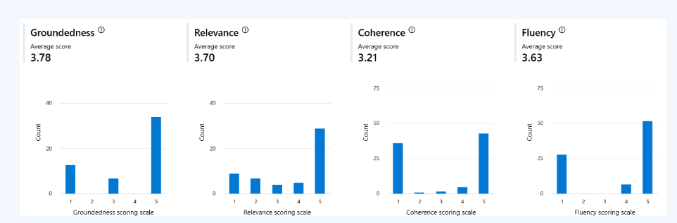
(sample) Evaluation Metrics for your GenAI App or AI Agent
Screenshot of some common(or off-the-shelf) Evals from AI Azure
Source Microsoft Azure

Slide 10
Build Test Data : Guidelines
Define Test Data Requirements
Build Input/output pairs tailored to your use case
Inputs: Cover diverse scenarios, edge cases, domain-specific variations.
Outputs: Clearly defined expected results.
Methods for Creating Test Data
Human-Generated Data: This is the best approach. It results in a high-quality dataset but expensive to do
Synthetic Data: Scalable using large models but requires validation
Use Case-Specific Considerations
Address unique needs like domain knowledge, personas, edge cases or interaction styles
Iterative Improvement
Golden Test Dataset
Input / output
Human created
Synthetic dataset

Slide 11
Appendix

Slide 12

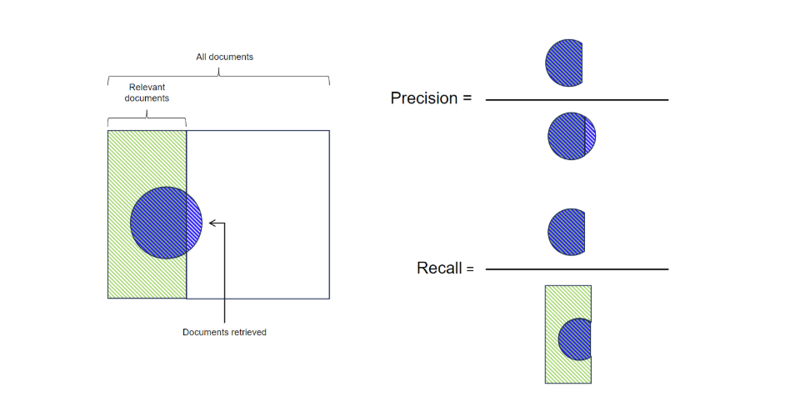
Precision & Recall
Of the documents you retrieved, how many were actually relevant?
Of the documents that were relevant, how many did you actually retrieve?
Source: Nvidia Deep Learning Institute

Slide 13
Precision , Recall and F1
Precision – Of all answers retrieved, how many were actually correct.
Useful when wrong answers are costly (e.g., legal search, medical advice). You’d rather show fewer but correct results.
Recall – Of all correct answers possible, how many did we retrieve.
Useful when missing answers is costly (e.g., research, intelligence gathering). You’d rather show more results even if some are wrong.
F1 – Balance score between Precision and Recall (high only if both are high).
Useful when you need a balance between finding most correct answers and not including too many wrong ones (e.g., general Q&A chatbots).
Source: Nvidia Deep Learning Institute

Slide 14
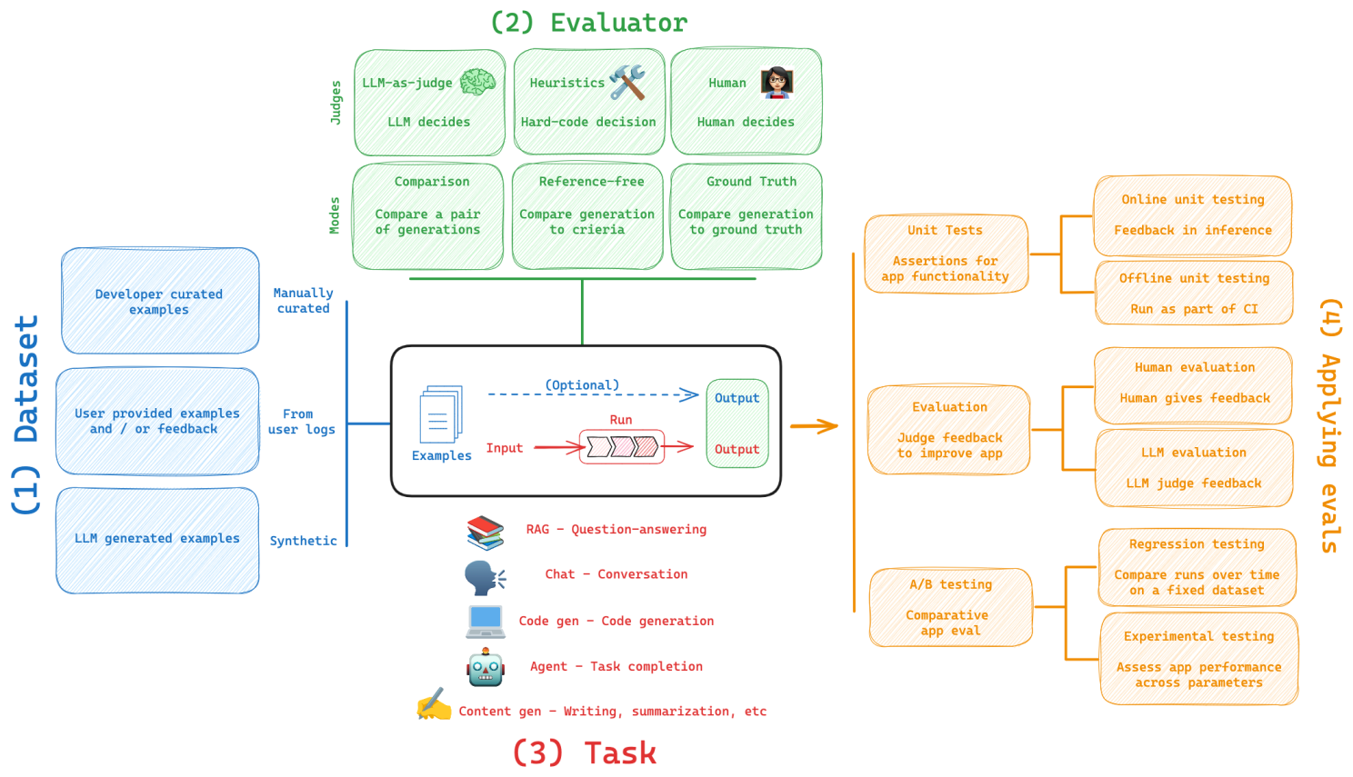
LangSmith Evals Framework

Slide 15


Appendix
Weights & Biases Weave framework helps customers evaluate, monitor, and iterate on their AI applications to accelerate the development and deployment process
LangSmith is a framework that helps developers build, test, and monitor natural language processing (NLP) applications

