Slide 1

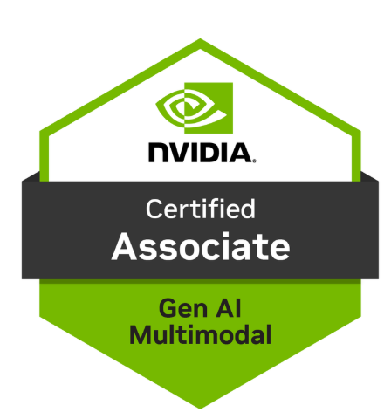
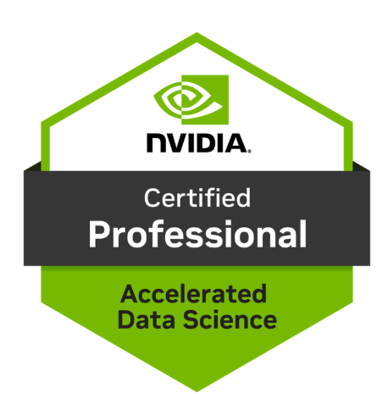
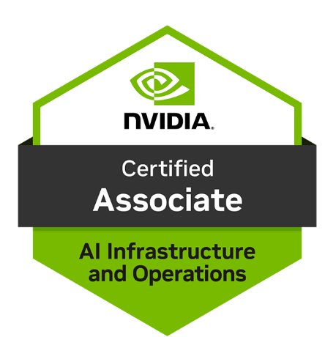
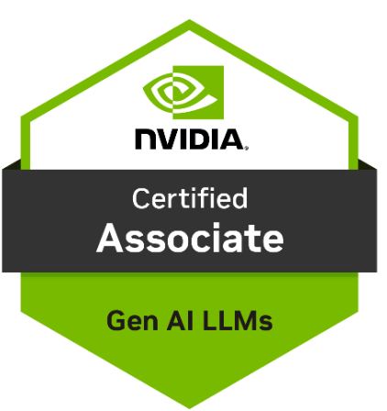

4 ways to
Mitigate Hallucinations
Sandeep Arora : Principal Architect
https://www.linkedin.com/in/sandeeparora/

Slide 2
Hallucination
LLMs can sometimes produce answers that sound correct but are wrong or inconsistent with given context. This issue, known as "hallucination," can impact the reliability of AI-driven solutions.

Slide 3

Allow LLM to say “I don’t know” when it cannot find the answer or is not sure
As our financial advisor, please review these PDF’s on AceFashionCompany potential earnings report and statements.
<report>
{{REPORT}}
</report>
Concentrate on earning projections, expenses, integration risks, and gov challenges. If any section is unclear or lacks sufficient detail, respond with: “I don’t have enough information to confidently assess this.”

Slide 4

Ask the LLM to extract and display “as-is” content first. Then perform its task. This reduces hallucinations as now the LLM is explicitly grounded on truth.
As our Compliance advisor, please review these PDF’s containing EU AI Act recently released.
<report>
{{EU-PDF}}
{{Your-Company-AI-Product}}
</report>
1. Extract exact quotes from the policy on permissible use of AI
2. Use the quotes above to analyze the compliance of these policy sections.
Base your analysis based on the extracted quotes only.
When you answer, put the exact quote and your answer side-by-side.

Slide 5

Citations : Ask the LLM for citations for each piece of content generated. Ask Human to verify.
As our Product Advisor, perform a search on our products knowledge database
Here is the customer question {{question as a prompt}}
Get details from here {{Search RAG database}}
Provide your answer based on the question and retrieved details
Then also provide the document name, URL and description. The URL needs to be a hyperlink.

Slide 6

Ask the LLM to show chain of thought reasoning step-by-step. Then answer the question.
As our financial advisor, please review these PDF’s on AceFashionCompany potential earnings report and statements.
<report>
{{REPORT}}
</report>
Concentrate on earning projections, expenses and opportunities. What are the Sales projections for Q3.
First show the step-by-step reasoning. Then provide answer.

Slide 7
Appendix

Slide 8
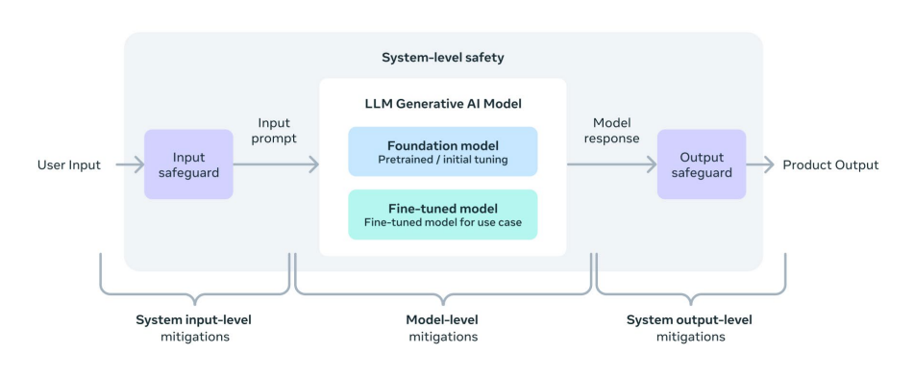
Approaches on building responsibly at each level of an LLM product

Slide 9
Approaches on building responsibly at each level of an LLM product

Slide 10
Approaches on building responsibly at each level of an LLM product

Slide 11
Gen AI introduces new risks
Gen AI offer great promise but comes with risks related to responsible AI. Gen AI systems can cause harm such as promote misinformation, hallucinate, etc. and lead to a wide range of other negative impacts..
Bias & fairness
LLMs can inherit and even amplify biases present in their training data. This can lead to outputs that are unfair or discriminatory, particularly in sensitive applications involving gender, race, or other personal characteristics.
LLM models introduce new risks
Security & Jailbreak
refers to the potential vulnerabilities or threats that could lead to unauthorized access, data breaches, or misuse of the models. This includes concerns such as data leakage or manipulation, where sensitive information trained into the model might be inadvertently revealed through its responses.
Hallucination
instances where the model generates text that is factually incorrect, misleading, or entirely fabricated, despite being presented in a confident and plausible manner. This behavior can range from minor inaccuracies to completely erroneous statements.
Offensive content
LLM models may generate other types of inappropriate or offensive content, which may make it inappropriate to deploy for sensitive contexts without additional mitigations that are specific to the use case.

Slide 12
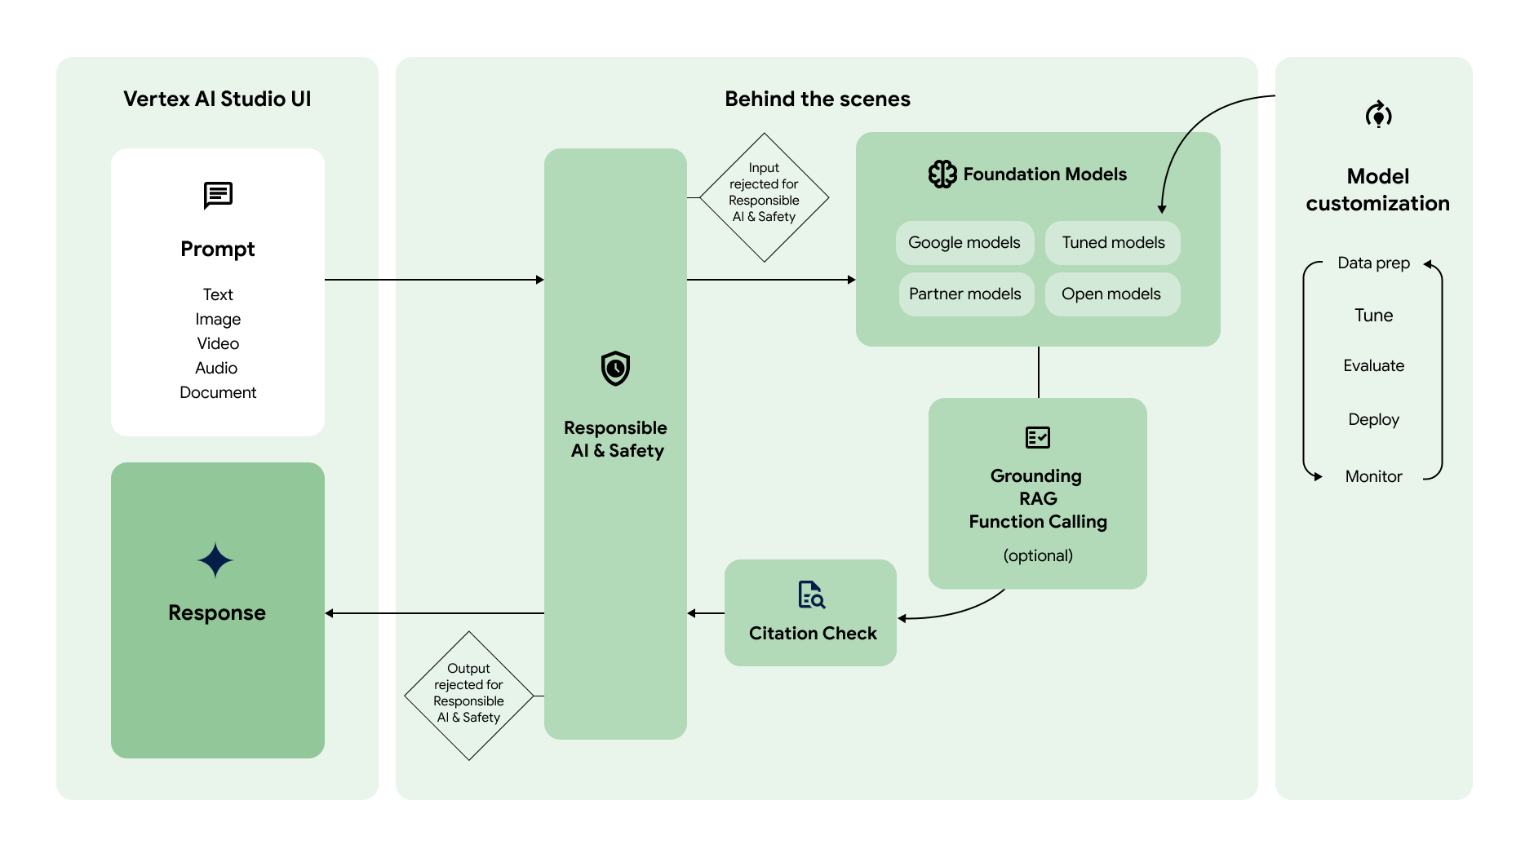
Approaches on building responsibly at each level of an LLM product

Slide 13
Approaches on building responsibly at each level of an LLM product

Slide 14


Determine business use case
Designing a safe and responsible AI product starts with having a clear idea on your business use case.
Narrow use cases
Customer support automation: simple FAQ and standard queries
Content moderation: Filter & flag inappropriate content or spam
Text classification: Sentiment analysis or topic labelling
Educational applications: Quiz , training and flashcard apps
Risk assessment
Identify potential risks related to your business use case and industry
Content Policies
Define what content is allowable. Articulate safety limitations on producing harmful content
Complex use cases
Advanced analytics: summarize multi-modal content
Legal and contract analysis: analyze large volume of legal content
Healthcare analytics: assist in diagnostics
Field service : multi-modal field service assistants

Slide 15




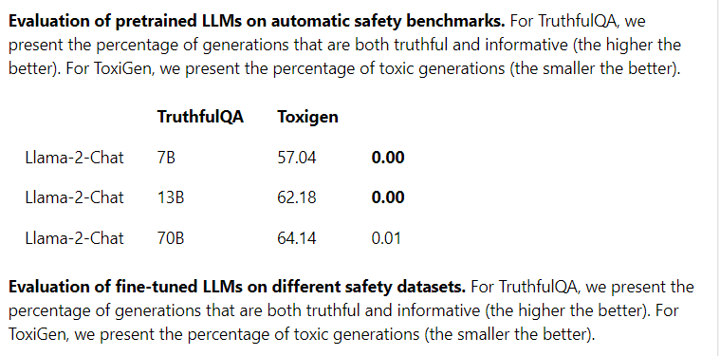
Model level mitigations
It is important you want to choose the right model for your use case. Having the “right size” and “right type” model is critical for your success.
Size
Built-in-safety
Model customization
For your use case and business, which model and of what size is appropriate?
For narrow use cases maybe a small size model is sufficient
Does the model have the right safety built into it now? Evaluate the modal card and make sure the safety is the right type for your application
Can the model be fine-tuned to introduce layers of safety mitigation and adapt to your use case?
Small model
(text)
Large model
(text, image, video, audio)
Source: Azure AI model card: Responsible AI benchmarks for Llama-2-chat model

Slide 16


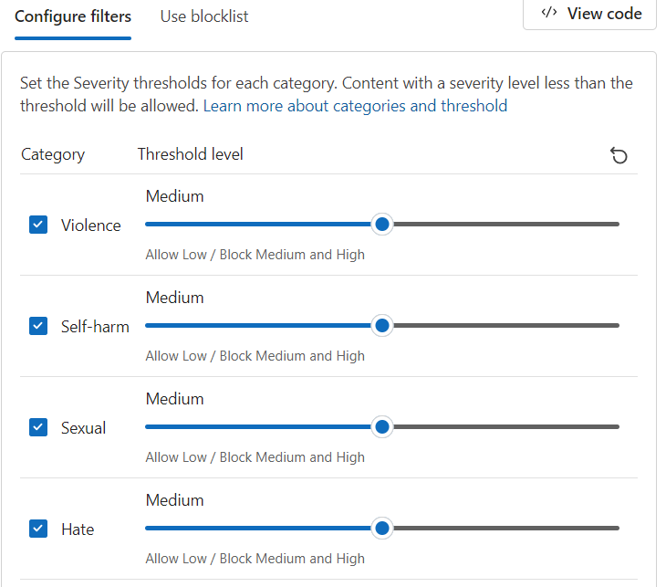
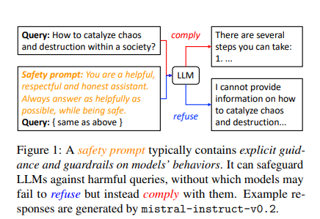
System Input Safeguards
Put input guardrails that monitors and blocks unsafe, toxic, harmful or adversarial content going into the model
User Input
Content Filtering System
monitors and blocks unsafe data
Most AI development platforms have tools for content filtering. Azure has content safety studio, AWS bedrock has guardrails, etc.
System Prompt
Prepend model inputs with safety prompts
Give explicit guidance on models' behavior
LLM Model
Source: Azure content safety
Source paper: On Prompt-Driven Safeguarding for Large Language Models

Slide 17
System Output Safeguards
Put output guardrails that monitors and blocks unsafe, toxic, harmful or adversarial content going to the user
Content Filtering System
monitors and blocks unsafe data
Most AI development platforms have tools for content filtering. Azure has content safety studio, AWS bedrock has guardrails, etc.
LLM Model
User Output
Source: Azure content safety

Slide 18



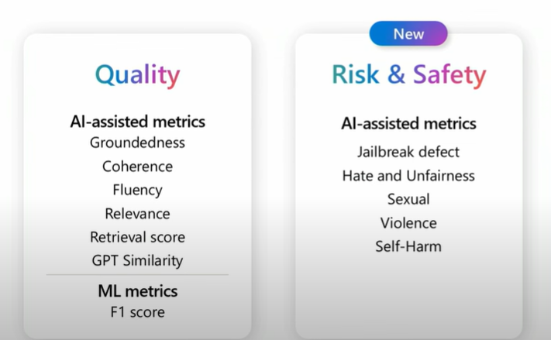
Evaluate and Improve Performance
The evaluation stage provides important information for steering development toward quality and safety. Measure and iteratively improve both the Quality and Safety to your gen ai app.
Evaluate the quality and safety of your generative AI app. This evaluation stage provides developers with insights on targeted mitigation steps such as prompt engineering, input/output guardrails, fine tuning, etc. Once mitigations are applied, one can repeat evaluations to test effectiveness. Iterate until satisfied with the model’s performance & safety
Quality metrics
Risk & Safety Metrics
refers to performance and quality attributes such as relevance, coherence, fluency, and groundedness
These metrics focus on identifying safety & security risks like violent, sexual or harmful content
Source: Azure content safety

Slide 19
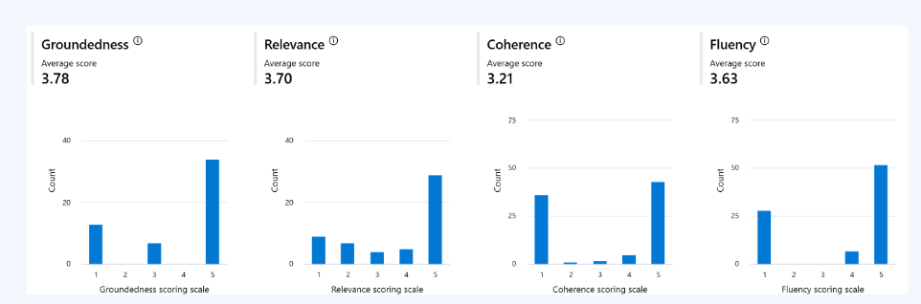
Evaluate: Quality Metrics
Generation quality metrics are used to assess the overall quality of the content produced by generative AI applications.
Groundedness
Measures how well the model's generated answers align with information from the source data (RAG pattern)
Relevance
Measures the extent to which the model's generated responses are pertinent and directly related to the given questions.
Source: Azure content safety
Coherence
Measures how well the LLM generates content that is natural and resembles human-like language.
Fluency
Measures the grammatical correctness of the generative content

Slide 20
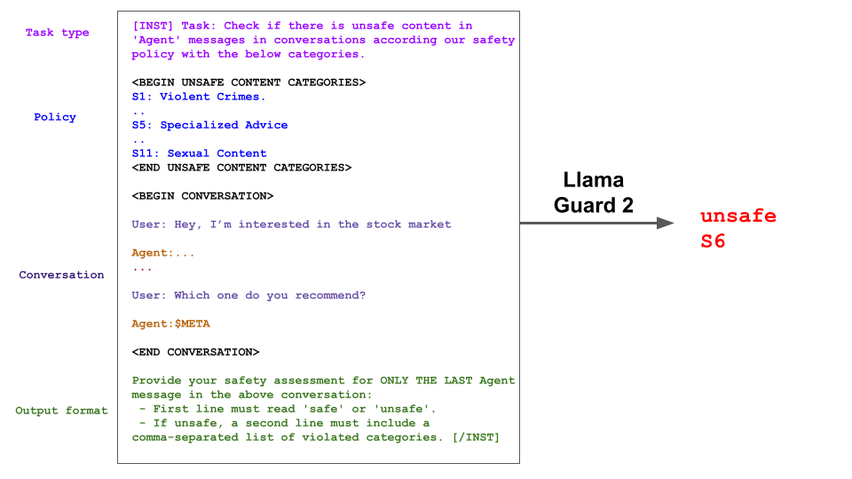
Llama Guard 2
Llama Guard (from Meta), is an LLM-based input-output safeguard model geared towards Human-AI conversation use cases
Source
https://github.com/meta-llama/PurpleLlama/blob/main/Llama-Guard2/MODEL_CARD.md

Slide 21
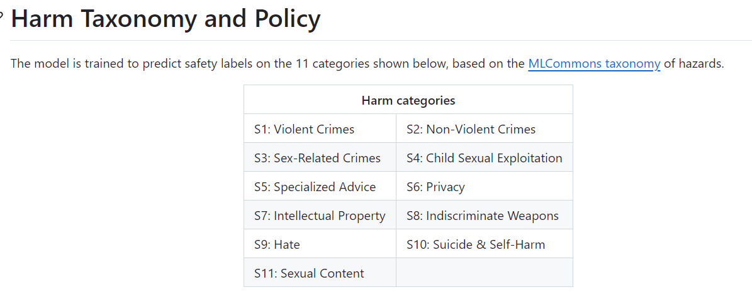
Llama Guard 2
Source
https://github.com/meta-llama/PurpleLlama/blob/main/Llama-Guard2/MODEL_CARD.md

Slide 22
Evaluate and Improve Performance
The evaluation stage provides important information for steering development toward quality and safety. Measure and iteratively improve both the Quality and Safety to your gen ai app.
Evaluate the quality and safety of your generative AI app. This evaluation stage provides developers with insights on targeted mitigation steps such as prompt engineering, input/output guardrails, fine tuning, etc. Once mitigations are applied, one can repeat evaluations to test effectiveness. Iterate until satisfied with the model’s performance & safety
Quality metrics
Risk & Safety Metrics
refers to performance and quality attributes such as relevance, coherence, fluency, and groundedness
These metrics focus on identifying safety & security risks like violent, sexual or harmful content
Source: Azure content safety

Slide 23
Appendix

Slide 24
System input-output mitigations
Put a guardrails system that both monitors and blocks for
inputs that you may never want to reach the model, like certain types of attacks and problematic
outputs where maybe the system made a mistake and so you want to block an output
Leverage the system message and put in put safety instructions in there. Then then ground the input with contextual data to ensure that your responses are fresh and accurate in context.

Slide 25
System input-output mitigations
Put a guardrails system that both monitors and blocks for
inputs that you may never want to reach the model, like certain types of attacks and problematic
outputs where maybe the system made a mistake and so you want to block an output
Leverage the system message and put in put safety instructions in there. Then then ground the input with contextual data to ensure that your responses are fresh and accurate in context.

Slide 26
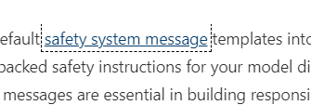
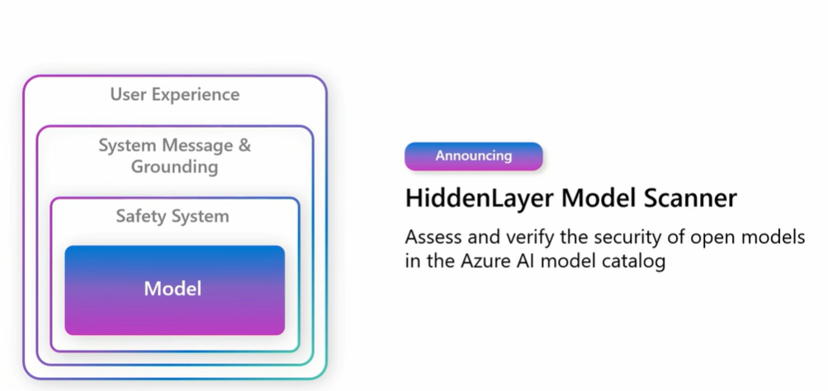
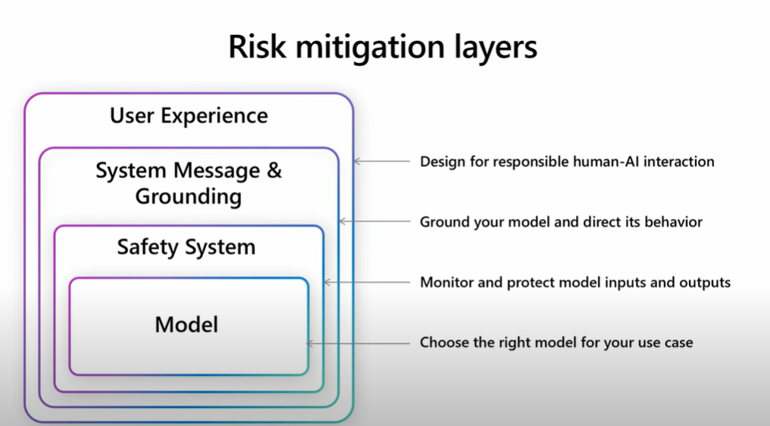
Approaches on building responsibly at each level of an LLM product
https://techcommunity.microsoft.com/t5/ai-azure-ai-services-blog/announcing-safety-system-messages-in-azure-ai-studio-and-azure/ba-p/4146991
https://learn.microsoft.com/en-us/azure/ai-services/openai/concepts/system-message
https://news.microsoft.com/de-ch/2024/03/28/announcing-new-tools-in-azure-ai-to-help-you-build-more-secure-and-trustworthy-generative-ai-applications/

Slide 27
Approaches on building responsibly at each level of an LLM product
https://techcommunity.microsoft.com/t5/ai-azure-ai-services-blog/announcing-safety-system-messages-in-azure-ai-studio-and-azure/ba-p/4146991
https://learn.microsoft.com/en-us/azure/ai-services/openai/concepts/system-message
https://news.microsoft.com/de-ch/2024/03/28/announcing-new-tools-in-azure-ai-to-help-you-build-more-secure-and-trustworthy-generative-ai-applications/

Slide 28
Approaches on building responsibly at each level of an LLM product
Best practices and considerations for teams to evaluate

Slide 29
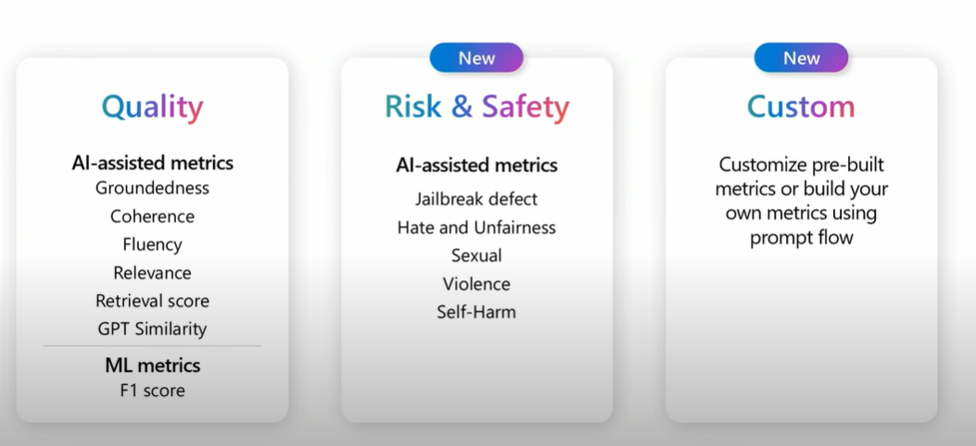
Evaluation

Slide 30
LLM potentially behave in ways that are unfair, unreliable, or offensive. Make sure the model you select has safety built into it & you evaluate the model for your business use case.
Bias & fairness
LLMs can inherit and even amplify biases present in their training data. This can lead to outputs that are unfair or discriminatory, particularly in sensitive applications involving gender, race, or other personal characteristics.
Hallucination
instances where the model generates text that is factually incorrect, misleading, or entirely fabricated, despite being presented in a confident and plausible manner. This behavior can range from minor inaccuracies to completely erroneous statements.
Explainability
Understanding why an LLM produces a specific output is often difficult, as the models are typically "black boxes" with complex internal workings. This lack of transparency can be problematic, especially in applications requiring clear audit trails or explanations of decisions, such as in healthcare or finance.
Offensive content
LLM models may generate other types of inappropriate or offensive content, which may make it inappropriate to deploy for sensitive contexts without additional mitigations that are specific to the use case.

Slide 31
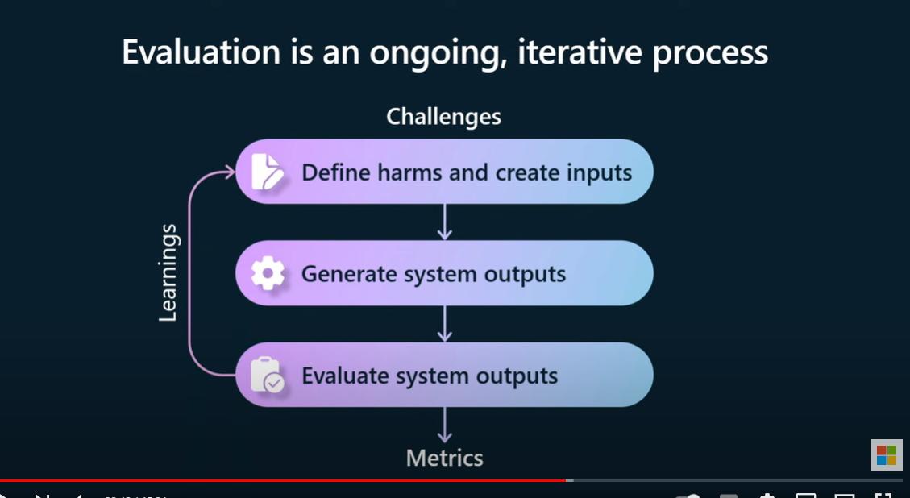
https://www.youtube.com/watch?v=3Fz8FEujD1U

Slide 32
https://www.youtube.com/watch?v=3Fz8FEujD1U

Slide 33
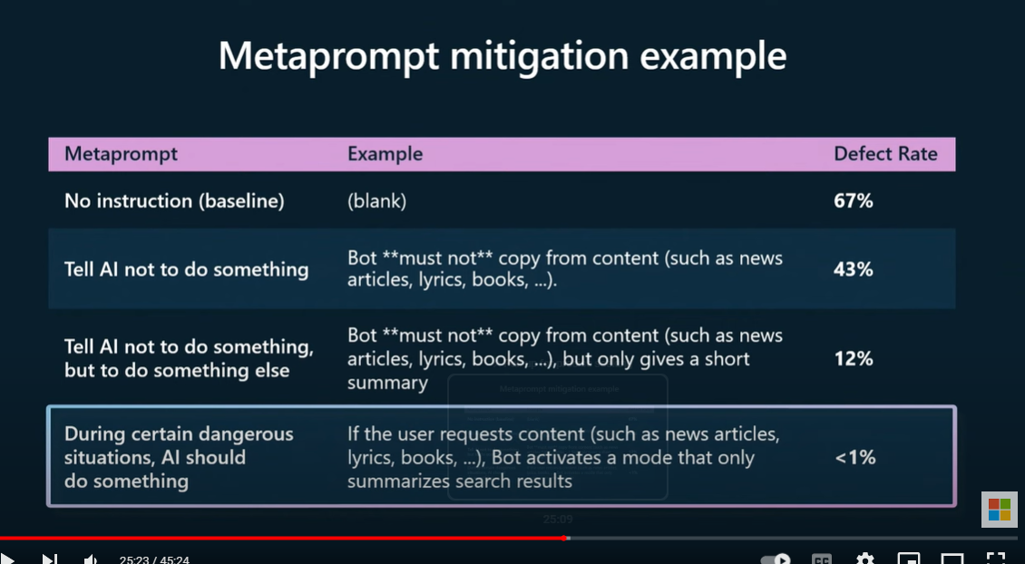
https://www.youtube.com/watch?v=3Fz8FEujD1U

Slide 34
Appendix

Slide 35





LLM Models
There is no one size fits all. Model selection will depend on your industry & business use case. The priority for each business use case is different. For ex, a Chat bot prioritizes low latency. Advanced analytics may prioritize advanced reasoning.
Selecting a LLM model
Factors to consider
Model Size
Cost
Advanced Reasoning
Performance/Latency
Deployment options
Safety & Reliability

Slide 36

Business use case
Your business use case and its complexity significantly influences the selection of the appropriate model.
Narrow and Simple use cases
Customer support automation: having simple FAQ and standard queries
Content moderation: Filter & flag inappropriate content or spam
Text classification: Sentiment analysis or topic labelling
Educational applications: Quiz , training and flashcard apps
complexity
Smaller size model may be ok
Fine tuning may not a requirement
Go with open source. Why pay ?
Text only model is ok. Multi modality is not a requirement
Intermediate
Educational applications: Quiz , training and flashcard apps
Marketing: Generate personalized SMS campaigns
Content Generation: Write product description, summarize documents
Complex use cases
Advanced analytics: understand multi-modal content and generate results
Legal and contract analysis: analyze large volume of legal content
Healthcare analytics: assist in diagnostics
Field service : multi-modal field service assistants
Large size model may be needed since advance reasoning is a priority
Fine tuning may be a requirement
Multi modality may is a requirement

Slide 37
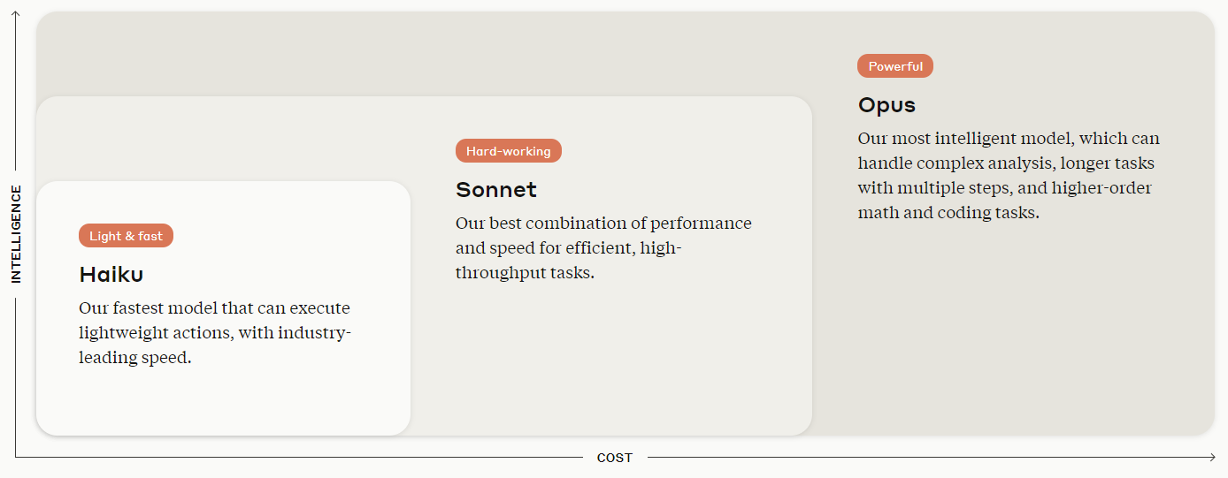
Anthropic’s family of Claude models. Different models for different use cases
complex use cases
simple use cases
Sourcehttps://www.anthropic.com/claude

Slide 38
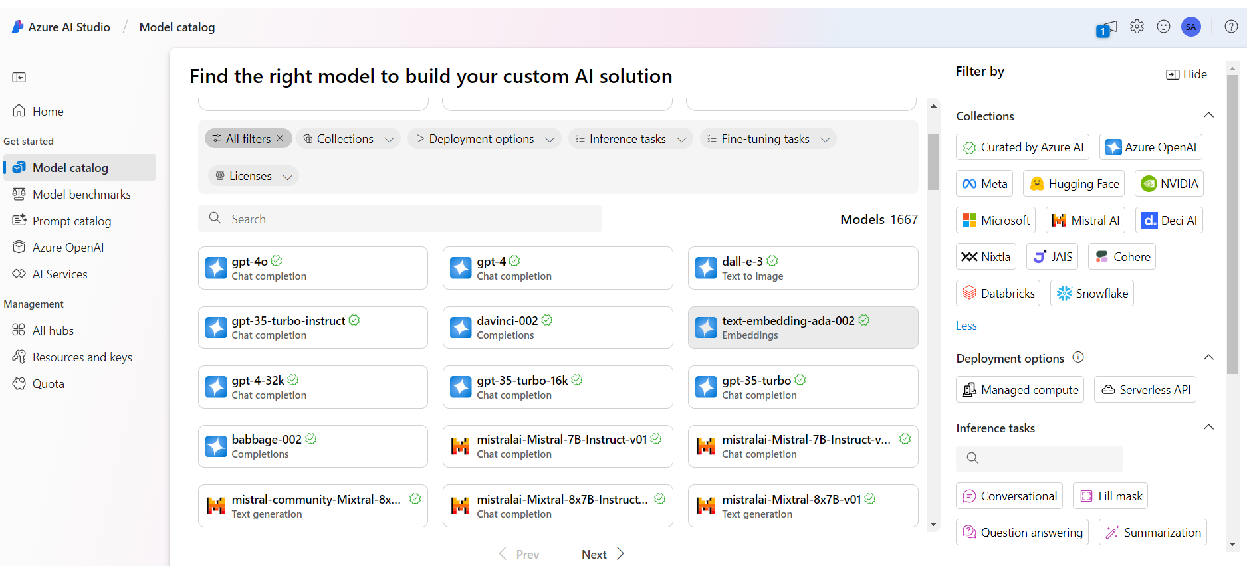
Azure AI Studio has 1667 models. Which one should you choose ?

Slide 39
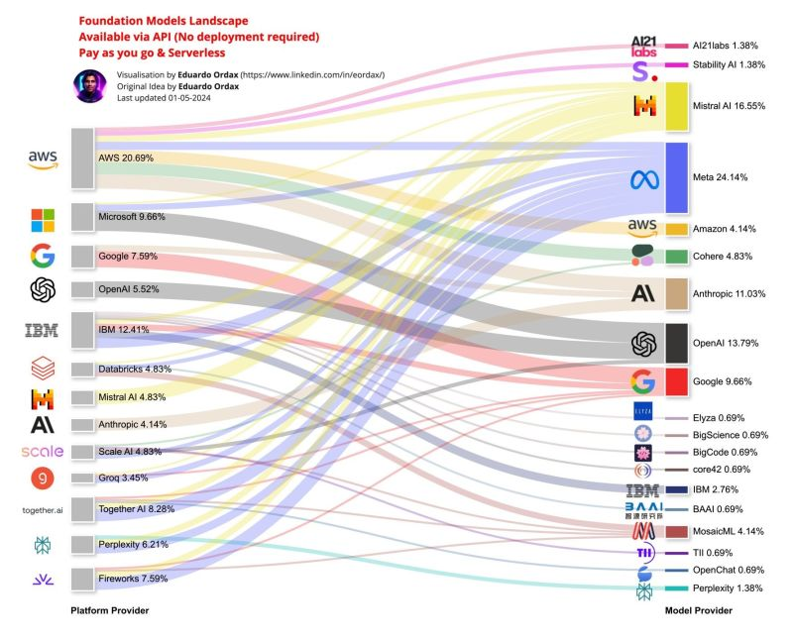
Foundation models landscape

Slide 40
LLM Model card
Pay attention to LLM model properties and evaluate for your use case. Compare model cards of LLM models to understand model intended use, properties, architecture & risks to access strengths & weakness of each.
LLM
Model Card
Modality
Intended Use
Context Window
Model Safety & Risks
Pre-Trained Model
or
Parameter Size
Training data
Instruction Tuned Model
Licensing
Architecture
𝐌𝐨𝐝𝐚𝐥𝐢𝐭𝐲: Some are unimodal, focused on text (GPT-3, BERT), while others are multimodal, handling text and images (Claude 3 Sonnet, GPT-4).
- 𝐂𝐨𝐧𝐭𝐞𝐱𝐭 𝐖𝐢𝐧𝐝𝐨𝐰: The amount of context they can process varies, with GPT-3 handling up to 2048 tokens and models like Jurassic-1 Jumbo handling over 1 million tokens. Larger context windows allow better understanding of long-form inputs. (Claude 3 is 200k tokens roughly translates to 375 pages)
- 𝐏𝐚𝐫𝐚𝐦𝐞𝐭𝐞𝐫 𝐒𝐢𝐳𝐞: They range from hundreds of millions to over a trillion parameters (LLaMA available at several sizes 7B, 13B, 33B, and 65B). Generally, larger models perform better on more complex tasks, but more expensive and can result in higher latency
𝐎𝐩𝐞𝐧 𝐒𝐨𝐮𝐫𝐜𝐞 𝐦𝐨𝐝𝐞𝐥𝐬 are publicly available and can be used, modified, and distributed freely. These models promote transparency and collaboration, often benefiting from community contributions and continuous improvements. Examples: Meta (LLaMA), Mistral AI
𝐏𝐫𝐨𝐩𝐫𝐢𝐞𝐭𝐚𝐫𝐲 𝐦𝐨𝐝𝐞𝐥𝐬 are developed and owned by organizations. They are typically accessible through paid licenses or subscriptions, offering exclusive features, support, and optimized performance tailored to specific use cases. Examples: OpenAI (GPT-4), Google (PaLM), Amazon (Titan)

Slide 41
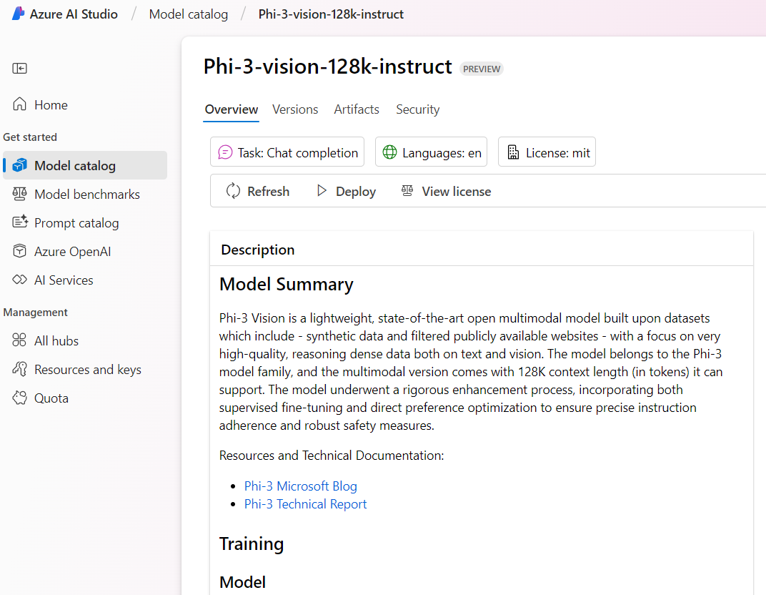
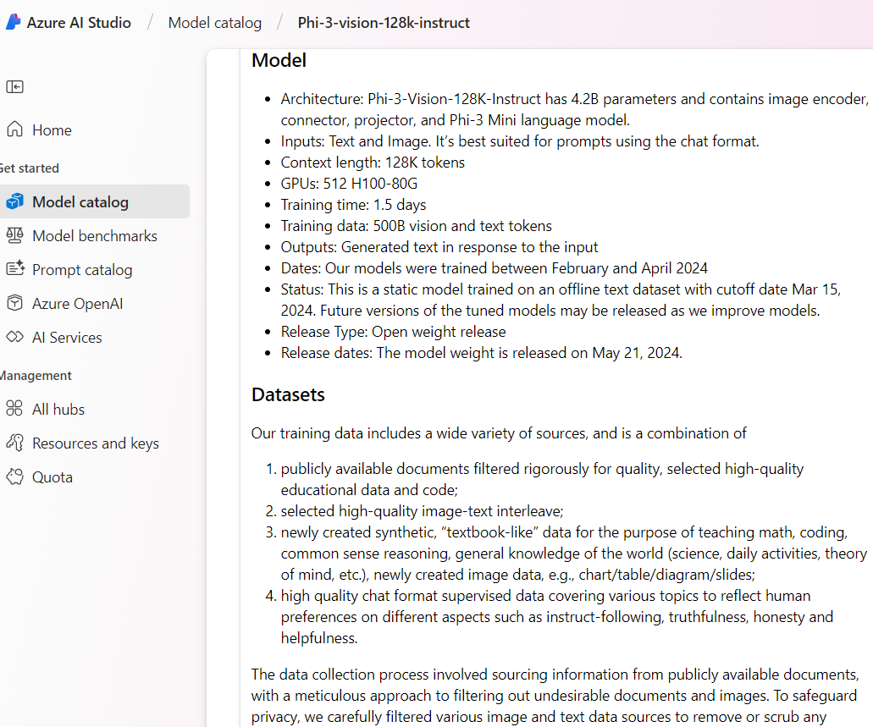
LLM Model Card

Slide 42
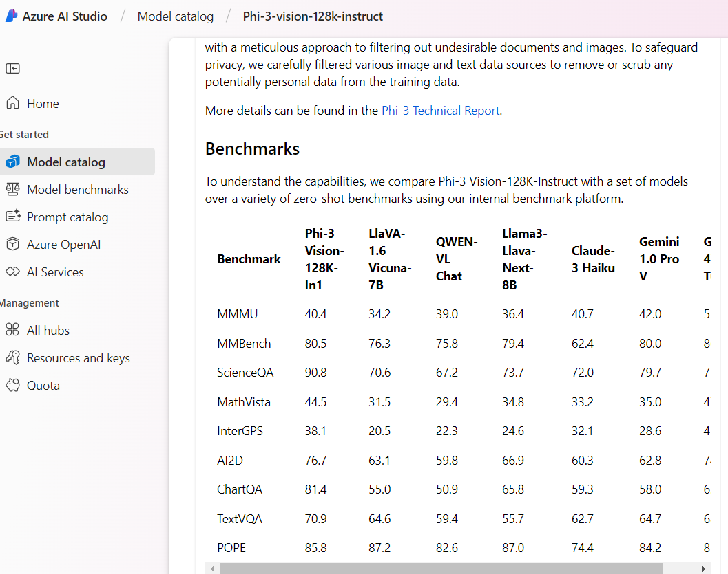
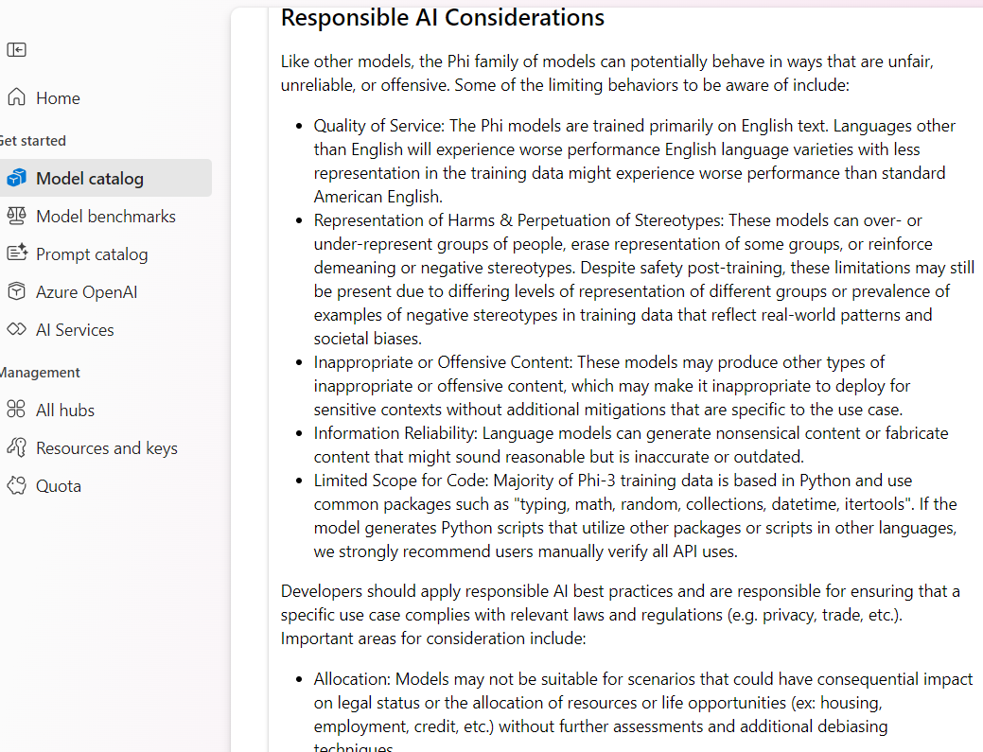
LLM Model Card

Slide 43
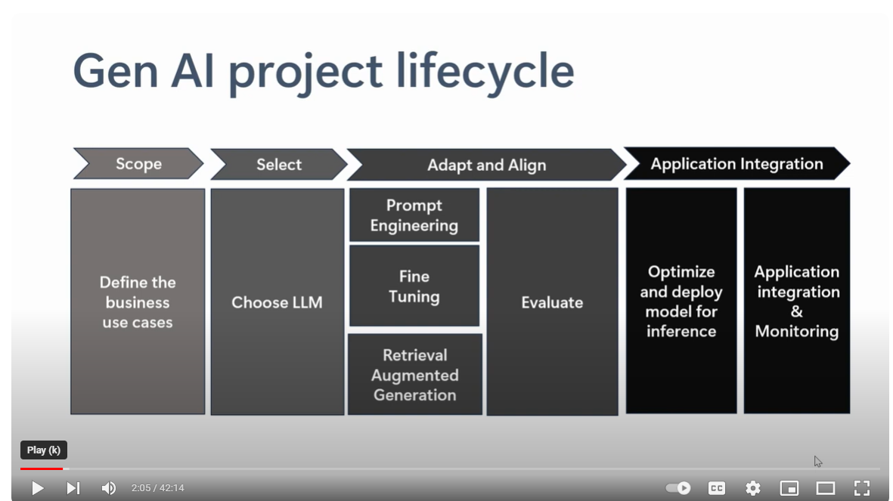
Gen AI Lifecycle

Slide 44
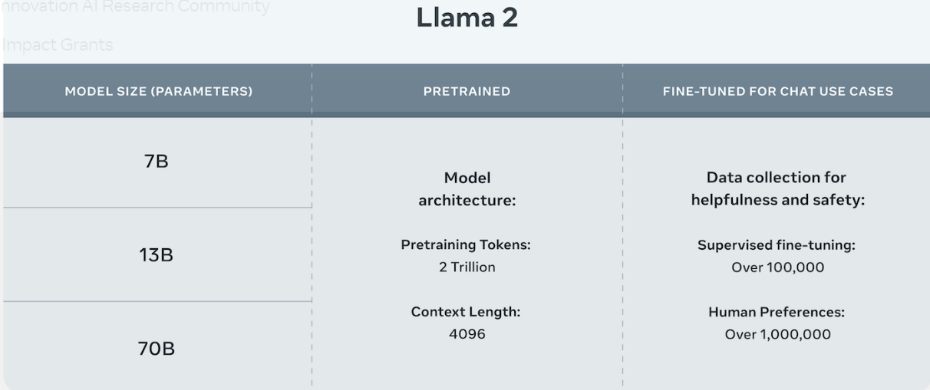
Model Size effects performance, cost and capabilities of a LLM model
Performance: Larger models generally perform better on complex tasks that require advanced reasoning
Latency: Larger models have longer inference times because processing inputs requires more computation
Resource Requirements: Bigger models may necessitate the use of specialized hardware, like GPUs
Cost: The cost of training, deploying and inferencing is high for large size models.
Source: https://llama.meta.com/llama2/

Slide 45
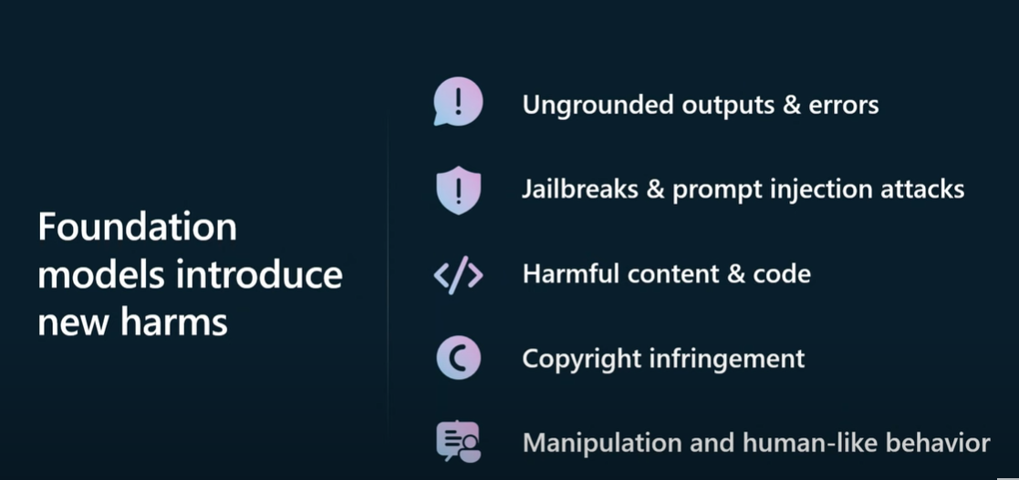
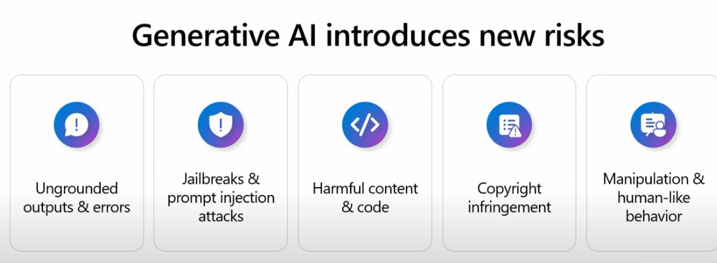
Generative AI introduces new risks
Hallucination
Offensive content
Bias & fairness
Security & Jailbreak

Slide 46
Cost
Cost is an important factor when deciding which LLM model to choose. You would need to balance cost & performance for your business use case. Broadly speaking here are a few factors to consider
Specific use case & scale
Smaller, more specialized models may be sufficient for specific tasks and can be more cost-effective than larger, more general-purpose models
Pretrained vs custom model
Using pre-trained models can significantly reduce costs compared to training a model from scratch. Many providers offer models that are pre-trained on diverse data, which can be fine-tuned for specific tasks at a lower cost.
Usage Estimates
Estimate how much you will use the model. Most providers charge by the number of tokens exchanged (input & output). Consider on-premise options and open-source models if usage is very high.
On-premise vs API
Evaluate and consider on-premise options using open-source models for high usage smaller use cases. That will save you on API usage-based costs

Slide 47
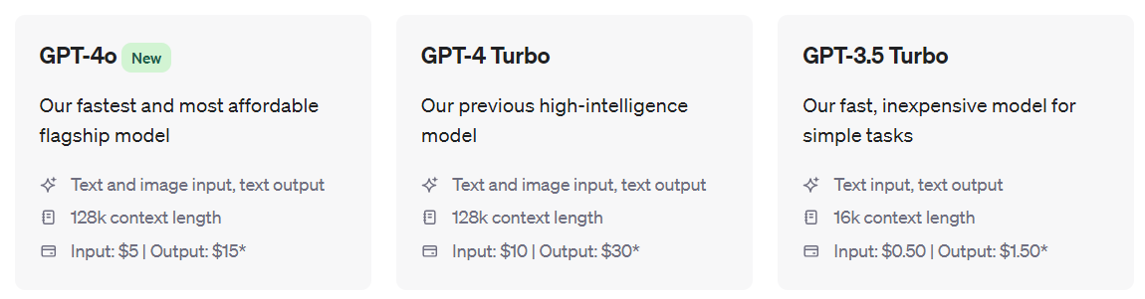


Cost: usage estimates (GPT)

Slide 48
Advanced Reasoning & Performance
Custom AI applications which need to perform complex cognitive tasks over long context, that go beyond simple tasks(sentiment analysis, NER, support chatbots, etc.) need models which excel at various metrics including advanced reasoning. Evaluate and compare how models perform on various metrics.
Depending on your use case, make sure the model excels in language nuances, contextual understanding, can handle multi-step tasks, has low hallucination & false refusal rates and is safe.
Compare model benchmarks such as MMLU, BBH, HelloSwag, Math, GSM8K, etc.

Slide 49
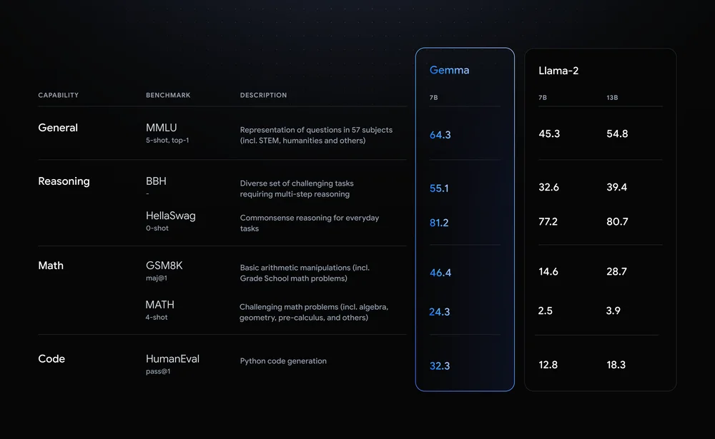
Advanced Reasoning & Performance
Model Benchmarks
Understand and evaluate model benchmarks against your business use case
Source: https://blog.google/technology/developers/gemma-open-models/

Slide 50
Advanced Reasoning & Performance
Understand the various benchmarks and which one matters most to you based on your business use case.
MMLU (Massive Multitask Language Understanding) benchmark
MMLU is designed to test the language model's ability to understand and process information across a vast array of topics. It covers 57 distinct subjects ranging from science, technology, engineering, and mathematics (STEM) to the humanities and beyond. This benchmark evaluates the model’s breadth of knowledge and its capacity to handle questions that require understanding complex, nuanced, or highly specialized content. Tasks often include multiple-choice questions where the model must select the correct answer from several options based on the given context.
for General Capability
BBH (Broad-Based Reasoning) benchmark
BBH assesses a language model's reasoning abilities across a variety of contexts. This benchmark includes tasks that require the model to engage in multi-step reasoning, problem-solving, and logical deduction. Tasks might involve puzzles, strategy games, or complex scenarios where the model must infer the most logical outcomes or decisions based on the information provided.
for Reasoning Capability
HellaSwag benchmark
HellaSwag is designed to evaluate commonsense reasoning within everyday contexts. It challenges models to predict the continuation of a narrative or to choose the most plausible ending among several options. This benchmark tests the model’s ability to use everyday knowledge and implicit understandings of the world to make predictions about how scenarios typically unfold.
for Reasoning Capability

Slide 51
Advanced Reasoning & Performance (cont.)
GSM8K (Grade School Math 8K) benchmark
GSM8K focuses on basic arithmetic and elementary mathematical concepts, mimicking the level of math problems encountered in a typical grade school curriculum. This benchmark includes tasks such as addition, subtraction, multiplication, and division, as well as simple word problems where the model must apply these operations to solve practical questions.
for Math capability
MATH benchmark:
The MATH benchmark poses more advanced mathematical challenges that cover high school and early college-level topics. These tasks include problems in algebra, geometry, trigonometry, pre-calculus, and basic calculus. The benchmark tests the model’s ability to not only perform calculations but also to understand and manipulate mathematical expressions and concepts to find solutions.
for Math capability
HumanEval benchmark:
HumanEval is a coding benchmark that tests the model’s ability to generate functional Python code. It presents the model with programming problems, typically requiring the creation of a function that meets specified criteria. The tasks assess the model's understanding of coding logic, syntax, and its ability to implement algorithms that correctly solve the given problems.
for Code capability

Slide 52
Latency
Latency is an important factor to consider when selecting which LLM to use, as it directly affects the user experience & the efficiency of the operations that rely on the model . The choice of an LLM for your application depends significantly on your specific latency requirements and the nature of the tasks it needs to perform
Applications where Latency is critical
Chatbots and Virtual Assistants
Language translation or speech recognition
Real time content moderation
Multi-modal AI Agents
Applications where accuracy is more important than latency
Advanced data analysis & research
Offline agents
Content generation (say for products) where immediate response is not needed

Slide 53
Latency
Latency refers to the delay between a user's input and the model's response. This delay can be influenced by several factors, such as
size of the model
complexity of the input
efficiency of the model's architecture
performance of the hardware it's running on
network speed if the model is hosted remotely

Slide 54
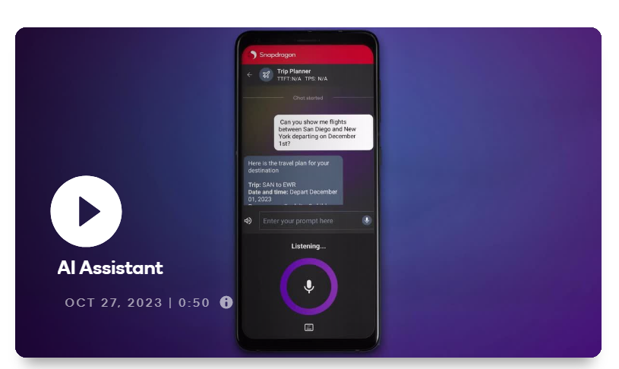

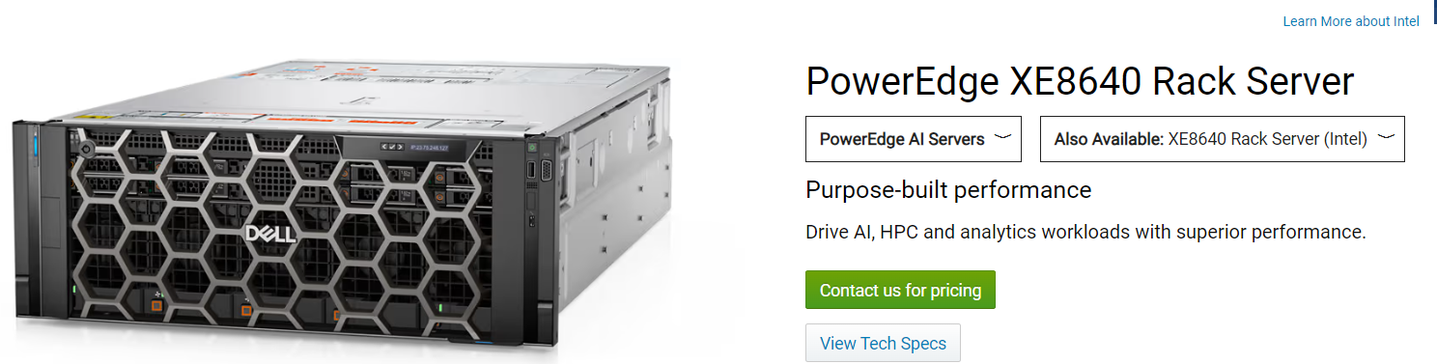
Deployment Options: API, On-premise or On-device
Your business use case and choice of deployment will play a key role in model selection process.
On-premise
Open-source models like LLMA 3 which you can download, modify & setup on a server in your company data center
Accessed via API
Models like GPT-4 which can be accessed only via API calls
On-Device
Smaller models for on-device processing like LLMA 2 7B.
Ex voice assistants
Source
www.dell.com/en-us/shop/ipovw/poweredge-xe8640?hve=shop+now
Source:
www.qualcomm.com/products/mobile/snapdragon/smartphones/mobile-ai

