Slide 1

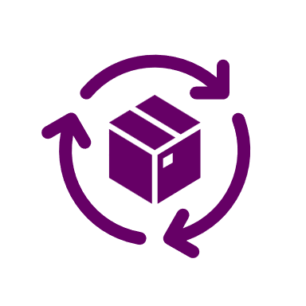
Model Customization
Jargon buster : what is DPO, PPO, RLHF, …
Sandeep Arora
www.trilyen.com

Slide 2
Model fine-tuning is the process of customizing a
pre-trained AI model to perform better on your business domain or specific tasks — making it smarter for your business needs.

Slide 3
Supervised Fine-Tuning
Model learns new domain or task specific behavior
Classification, structured extraction, formatting
Reduce cost by replacing long prompts
Direct Preference Optimization (DPO)
Learns human like preferences
Align chatbot to brand tone
Optimize a model to favor certain output over others
Kind of subjective alignment
Reinforcement Fine-tuning
Teach a model to nuanced & complex human preferences
Ex Multi-turn reasoning
Medical, Legal etc.
Distillation
A smaller model learns to mimic a larger model
Deploy models on the edge

Slide 4
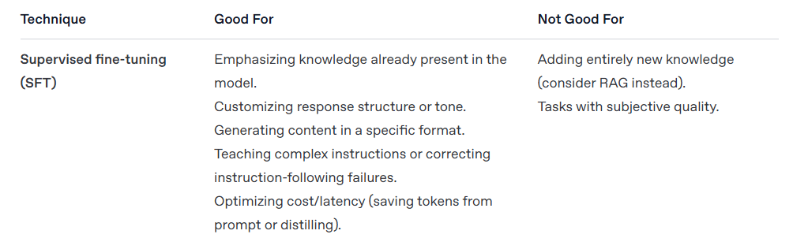
Supervised Fine-Tuning
Model learns domain or task specific behavior
Classification, structured extraction, formatting
Reduce cost by replacing long prompts
Data
Input
Output
Teach a model specific skills using supervised fine-tuning.
Step 1: Collect high-quality input-output pairs (e.g., questions & correct answers).
Step 2: Fine-tune the Base Model directly on this data, so it learns to replicate the desired behavior or task..
Input
Output
Input
Output
Input
Output
Input
Output
Source: https://cookbook.openai.com/examples/fine_tuning_direct_preference_optimization_guide

Slide 5
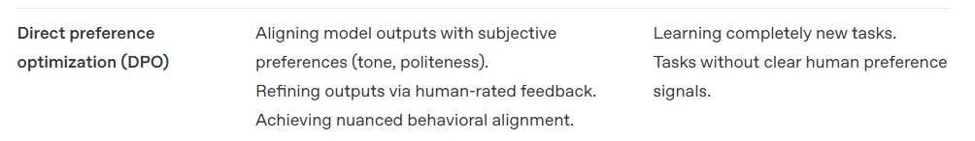
Direct Preference Optimization (DPO)
Learns human like preferences
Align chatbot to brand tone
Optimize a model to favor certain output over others
Kind of subjective alignment
Data
Input
Good Output
Bad Output
Teach a model human preferences using direct preference optimization.
Step 1: Collect prompt-response pairs with human or AI rankings (e.g., Response A is better than B).
Step 2: Fine-tune the Base Model to prefer higher-ranked responses without needing a separate reward model.
Input
Good Output
Bad Output
Input
Good Output
Bad Output
Input
Good Output
Bad Output
Input
Good Output
Bad Output
Source: https://cookbook.openai.com/examples/fine_tuning_direct_preference_optimization_guide

Slide 6
Reinforcement Fine-tuning
Teach a model to nuanced & complex human preferences
Multi-turn reasoning
Medical, Legal etc.
What is RLHF ?
RLHF is a training framework that teaches AI models to follow human preferences by combining human feedback with reinforcement learning techniques.
Step 1: Build the Reward Model
Start with a Base Model (pretrained language model)
Generate multiple responses for a prompt using the base model
Humans compare responses and select the preferred one
Train a Reward Model (RM) to predict human preferences
Reward Model has learnt to score new responses based on past human choices
Step 2: Fine-Tune the base model using PPO
Start with the same Base Model (pretrained language model)
Build your prompt database, which is real-world user queries or task-specific inputs
Generate response and use the Reward Model to assign scores to new model outputs
Apply PPO (Proximal Policy Optimization)
→ A reinforcement learning algorithm that updates the base model
Goal: Make the model generate responses that maximize reward (i.e., human preference)

Slide 7
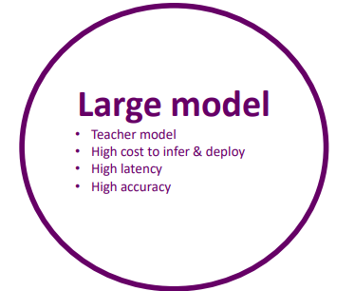
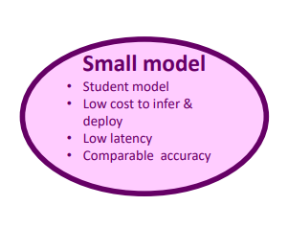
Distillation
A smaller model learns to mimic a larger model on a specific task
Deploy models on the edge
Large Model generated Data
Input
Output
Input
Output
Input
Output
Input
Output
Input
Output
Teach a smaller model to behave like a larger model on a specific task
Step 1: The large, high-performing Teacher Model generates responses to a wide range of prompts.
Step 2: A smaller Student Model is trained to mimic those responses, achieving similar quality with faster and lighter performance.

