Slide 1


DeepLearning
Sandeep Arora : Principal Architect
https://www.linkedin.com/in/sandeeparora/

Slide 2
Artificial Intelligence
AI is a broad field of computer science that involves building computer systems to do things that normally require human intelligence. Let us understand it step by step
AI
ML
Machine Learning (ML): Uses statistical software programs or models (like linear regression, decision trees, or k-means) to learn patterns from human labelled data and make predictions.
Deep Learning (DL): Uses multi-layered neural networks to automatically learn complex features, like identifying a cat from pixels.
Generative AI: A deep learning branch that generates new data (e.g., text, images, music) similar to what it was trained on.
DL
Gen AI

Slide 3
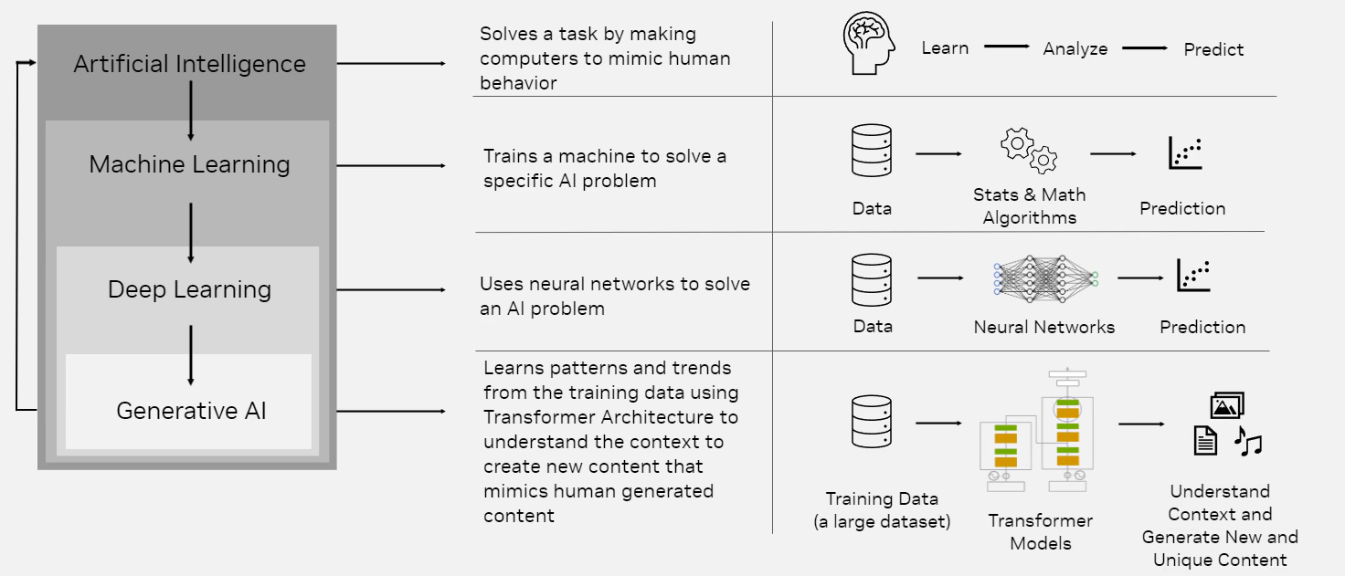
NVIDIA Academy: https://vimeo.com/1007377856

Slide 4
In this deck we will talk about Deep Learning and Neural Networks
NVIDIA Academy: https://vimeo.com/1007377856

Slide 5
Machine Learning (ML):
Learns patterns from structured data using algorithms like decision trees or linear regression. Requires manual feature engineering.
vs
Deep Learning (DL):
A subset of ML that uses neural networks (many layers) to automatically learn features—best for complex data like images, text, audio.

Slide 6
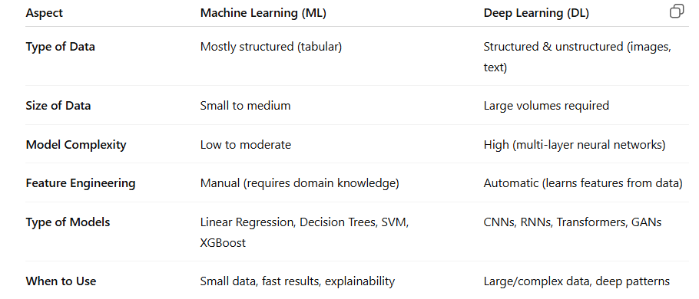
Machine Learning (ML) vs Deep Learning (DL)

Slide 7
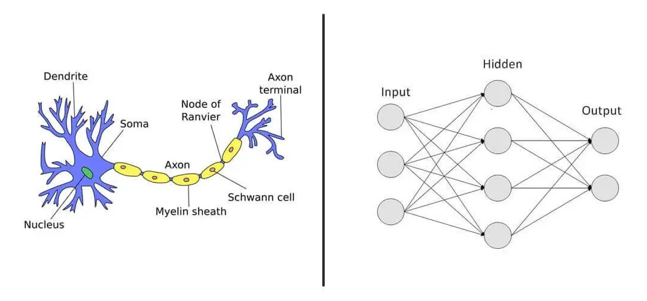
Neural networks are a type of computer algorithm that attempts to copy the structure of the human brain
Source: https://www.unaligned.io/p/neural-networks-simulating-human-brain-ai

Slide 8

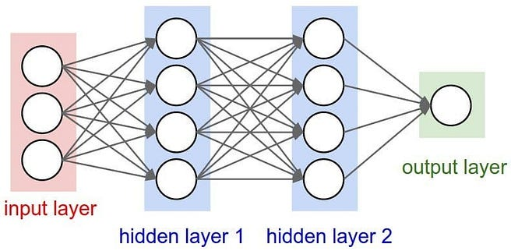
What is a neural network?
In simple terms, a neural network is just a complex software algorithm
Layer is the stage or step in the network where a group of nodes run together
Node is like a tiny software function. It is also called an Activation Function.
Each neural network has parameters called weights and bias. Relax, these are just numbers.
Weights: Numbers that determine the strength of the connection between two nodes.
Bias: An extra number value for each node. Each node (except input nodes) typically has one bias. Bias just helps the neural network make better predictions.
Source: https://medium.com/@jeslurrahman/simply-understanding-artificial-neural-networks-ann-deep-learning-10b19e2eadca

Slide 9
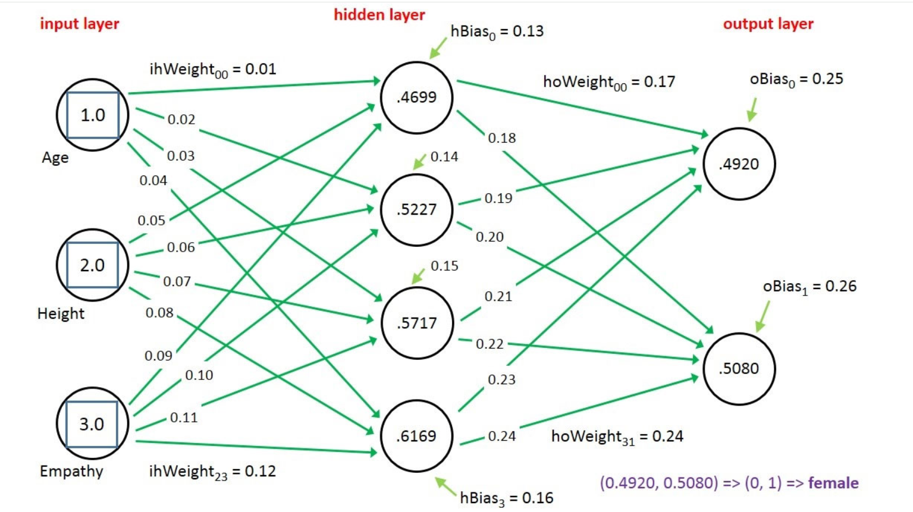
How do neural networks learn?
The goal of training a neural network is to build a model that can accurately predict training data
After training, it can be used to make predictions on new examples that the model has not yet seen
During training, the weights and biases are updated to reduce prediction error.
When fully trained, they hold the learned patterns that allow the network to make accurate predictions on new data.
The learning is saved inside the neural network as weights and bias
Source: https://visualstudiomagazine.com/articles/2015/08/01/neural-network-binary-classification.aspx

Slide 10
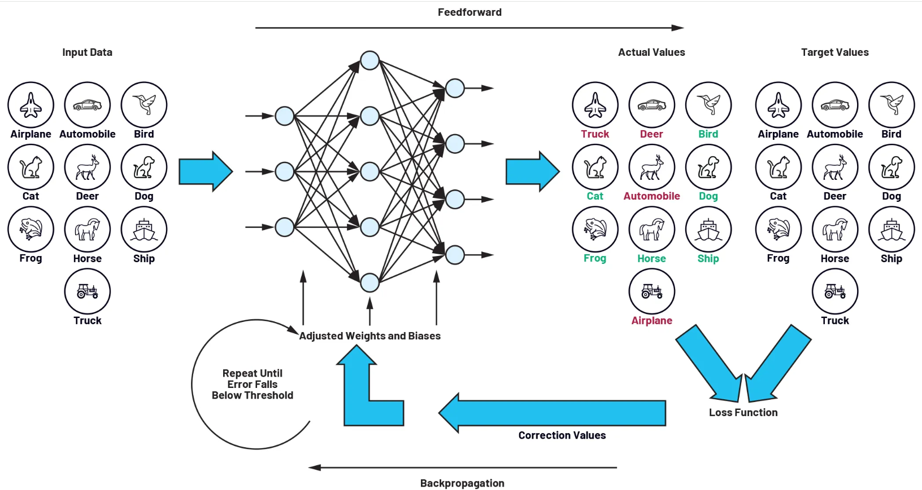
Source: https://www.analog.com/en/resources/analog-dialogue/articles/training-convolutional-neural-networks-what-is-machine-learning-part-2.html

Slide 11

Steps involved in neural network training
Input Data: Images (like cat, dog, car) converted to numbers are fed into the neural network.
Feedforward: Data flows through layers of nodes to produce predictions (actual values).
Compare Output: The model’s predicted labels are compared to the correct target values.
Loss Function: Calculates the difference (error) between predicted and target values.
Backpropagation: The error is sent backward through the network to compute how much each weight and bias contributed.
Adjust Weights and Biases: The network updates its weights and biases to reduce the error.
Repeat: The process continues until the prediction error is low enough.
Training stops when the error is low or performance plateaus. The trained model is then saved, deployed, and used for inference—making predictions on new, unseen data.
Top image source: www.analog.com/en/resources/analog-dialogue/articles/training-convolutional-neural-networks-what-is-machine-learning-part-2.html

Slide 12
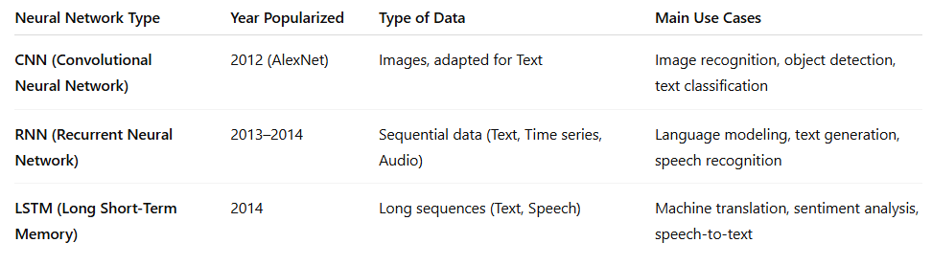
Different Types of Neural Networks

Slide 13
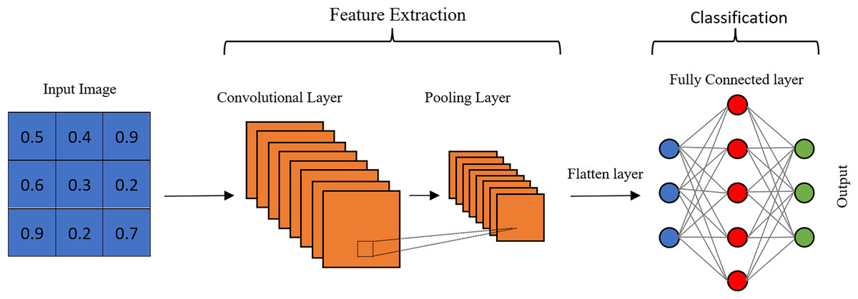
CNN – For Image Recognition
Deep Convolutional Neural Network (CNN) is a special type of neural network, specialized for image prediction
AlexNet is a deep convolutional neural network (CNN) used for image classification. It has 8 layers and helped revolutionize deep learning in 2012 by winning the ImageNet competition.
Source: https://peerj.com/articles/cs-1395/

Slide 14

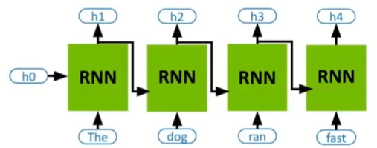
RNN for Text
What is an RNN
RNN (Recurrent Neural Network) is a type of neural network designed to handle sequential data, like natural language or time-series. It maintains memory by passing hidden states from one time step to the next.
.
You must have seen many tools where when you enter a few words, it completes it for you. Here sequence is important.
Source: https://www.youtube.com/watch?v=PXc_SlnT2g0

Slide 15
Next Step: Download Transformers and

