Slide 1
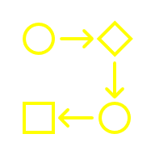


The case for
Right Sizing AI Models
AI Mindset

Slide 2

Most teams treat LLMs like a one-size-fits all solution.
Using a frontier model like (OpenAI GPT 5.2 or Claude 3.5) for every task is like hiring a PDD to do data entry work.
Exploding costs
Latency bottlenecks
Vendor lock-in

Slide 3
Most teams treat LLMs like a one-size-fits all solution.
Using a frontier model like (OpenAI GPT 5.2 or Claude 3.5) for every task is like hiring a PhD to do data entry work.
Exploding costs
Latency bottlenecks
Vendor lock-in
AI Cost TOO High
AI projects are time consuming
AI project disappointment
AI is not 100% accurate
AI is slow

Slide 4
Right sizing strategy to ensure we use the most efficient model for every specific business requirement
Task specific models
SLM First Approach
Finetuning (Distillation, …)
Model Optimization

Slide 5
Task specific models
1
Match model size to task complexity
Task Type | Intelligence Needed | Model
Text classification | Low | SLM
Data extraction | Low-medium | SLM
Summarization | Medium | Mid-size LLM
Multi-modal reasoning | High | LLM
Reasoning & Planning | High | LLM
PDF Reading | Medium-High | Use Model specialized in PDF reading
Evaluation | Medium | Mid-size or topic specific expert model

Slide 6
2
SLM First Approach
Use Small Language Models first. Move up if needed.
Smaller, faster, cheaper models
Optimized for specific tasks
Often 10–20x cheaper per request
Task like these do not need frontier models
Classification (intent, sentiment, routing)
Entity extraction
Structured data generation
Simple summaries
Tool selection inside agents

Slide 7

2
Small Language Models are lightweight versions of LLMs
LLM
Gemini, GPT 4
SLM
Phi, Gemma
Focused Expert
Task Specific
1B – 10B parameters
General Genius
Multi-modal
70B +

Slide 8
2
The need of Small Language Models
Cost Efficiency
Require less compute & are cheaper to run
Data Privacy
Can be deployed on-premise, ensuring compliance & security
Low Latency
Faster inference due to small size
Deployment Flexibility
Many can run on-device, at the edge, or offline
Avoid Vendor Lock In
Avoid reliance of costly API vendors
Accuracy for task
With fine tuning SLMs can perform as-good or even better than LLMs

Slide 9
3
Fine Tuning (Distillation, SFT, ..)
Add new knowledge to SLM to improve accuracy
Frontier model can distill knowledge to a SLM
New knowledge can be added to a SLM using SFT
New reasoning can be added to a SLM via RLHF

Slide 10
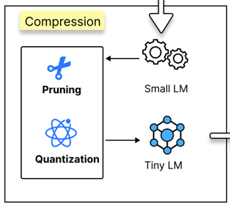
4
Model Optimization
Techniques that reduce model size and compute without materially reducing accuracy.
Pruning: Remove low-impact parameters (weights) while preserving accuracy
Quantization: Reduce numerical precision of weights and activations to improve efficiency
Source: https://arxiv.org/pdf/2504.13471 (From Large to Super-Tiny: End-to-End Optimization for Cost-Efficient LLMs)

Slide 11
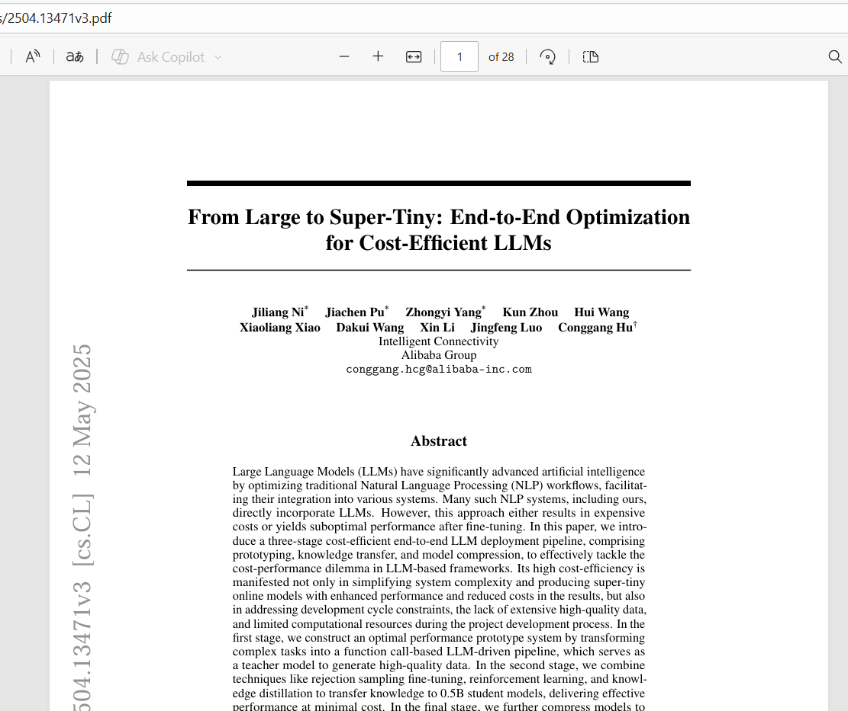
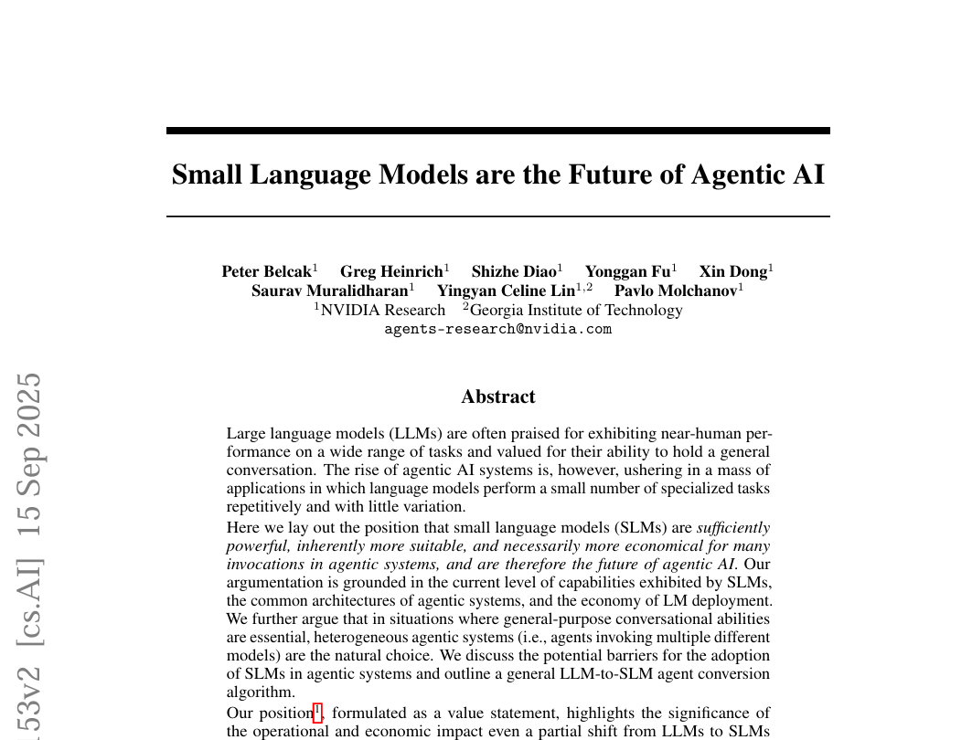
Reference: I encourage you to read these papers

