Slide 1
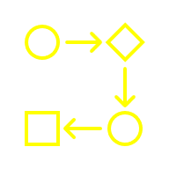

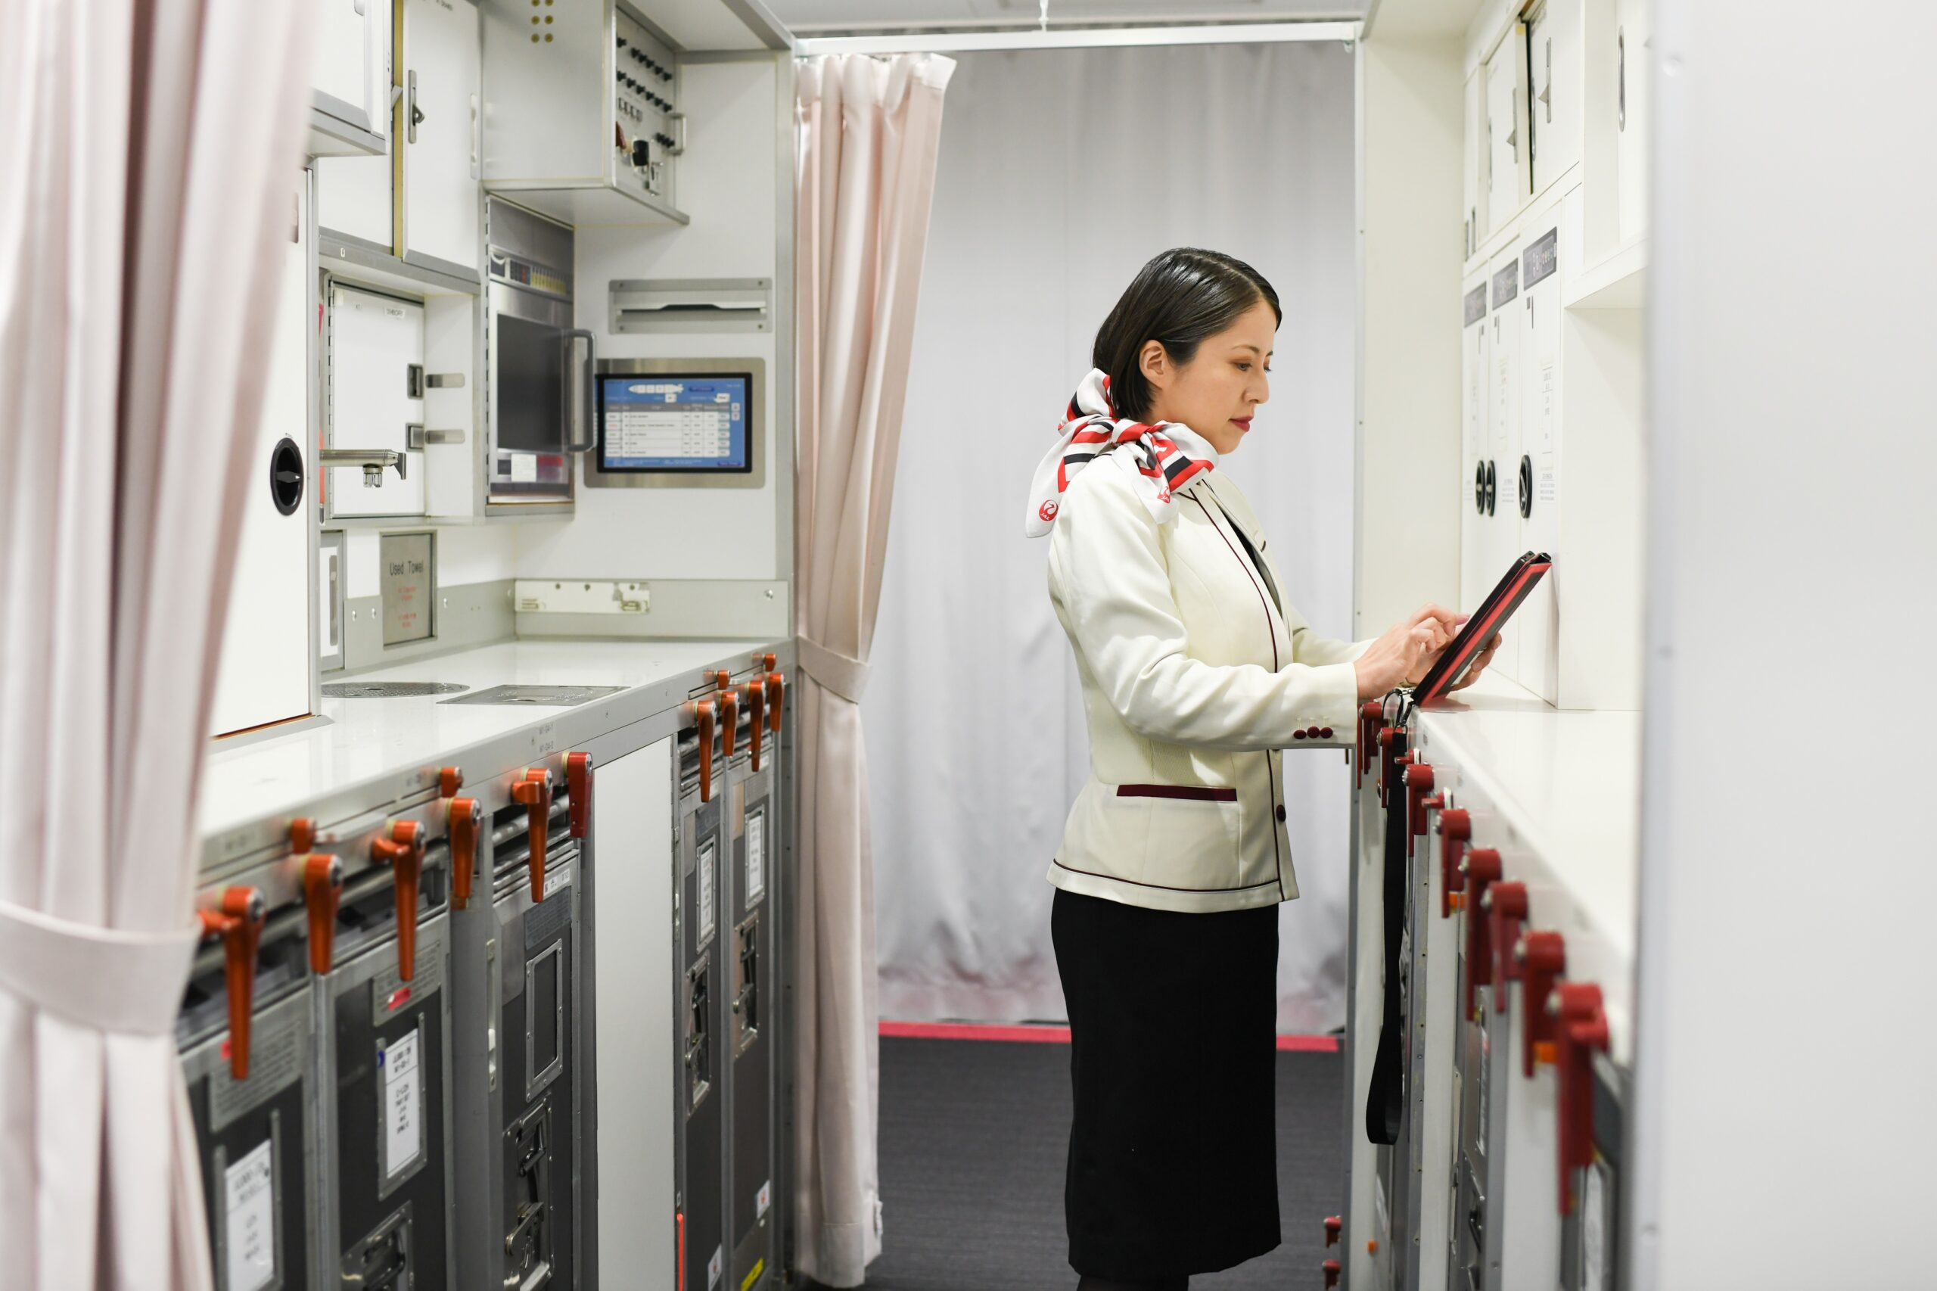



Small Language Models

Slide 2

Small Language Models are lightweight versions of LLMs
LLM
Gemini, GPT 4
SLM
Phi, Gemma
Focused Expert
Task Specific
1B – 10B parameters
General Genius
Multi-modal
70B +

Slide 3
The need of Small Language Models
Cost Efficiency
Require less compute & are cheaper to run
Data Privacy
Can be deployed on-premise, ensuring compliance & security
Low Latency
Faster inference due to small size
Deployment Flexibility
Many can run on-device, at the edge, or offline
Avoid Vendor Lock In
Avoid reliance of costly API vendors
Accuracy for task
With fine tuning SLMs can perform as-good or even better than LLMs

Slide 4
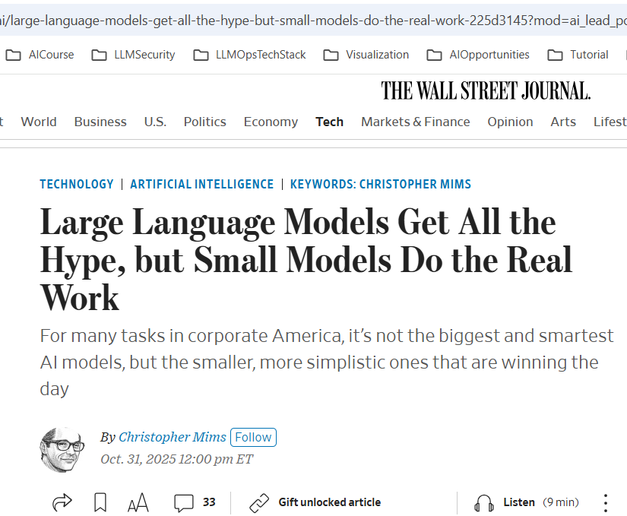

Slide 5
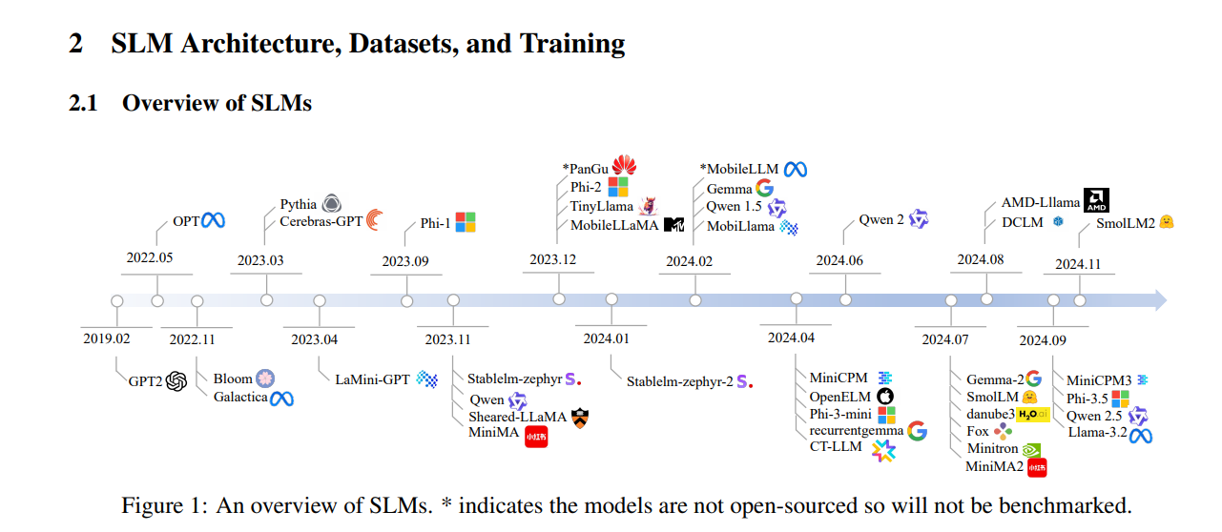
Source: https://arxiv.org/pdf/2409.15790

Slide 6
Challenges to Consider
AI Expertise Needed
Fine-tuning and self-hosting requires technical skills compute & are cheaper to run
Scalability
If your use grows, retraining the model or upgrading may be needed
Ongoing Maintenance
Models need monitoring, updates, and lifecycle management.

Slide 7
Japan Airlines AI App built using Microsoft Phi SLM reduces handover time from 1hr to 20 minutes, works offline & can translate
Japan Airlines cabin attendants need to report inflight events (sick passenger, delay, broken seat, etc. ) for handover. With this AI App, cabin attendants type a few keywords, check a few boxes . The AI app asks few follow up questions and generates the report.
Source: https://news.microsoft.com/source/asia/features/japan-airlines-new-ai-app-will-make-it-easier-for-cabin-attendants-to-report-inflight-events-with-microsofts-phi-4-small-language-model/
https://www.fujitsu.com/global/about/resources/news/press-releases/2025/0410-01.html?utm_source=chatgpt.com

Slide 8
Objective: Improve job recommendations
Problem: Poor user experience and lost trust due to low-quality job recommendations

Slide 9
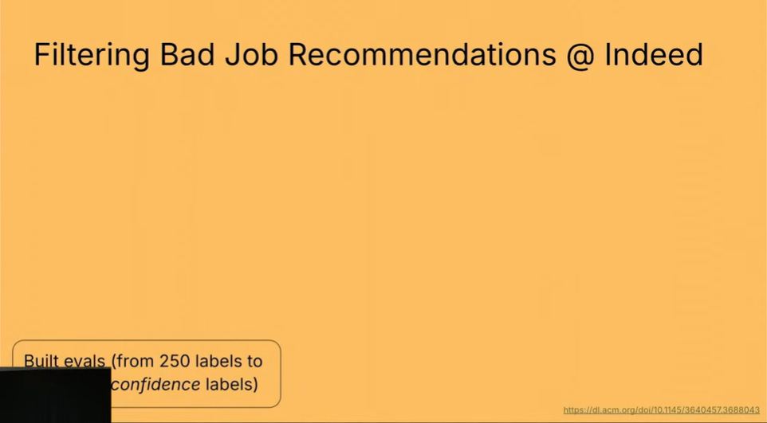
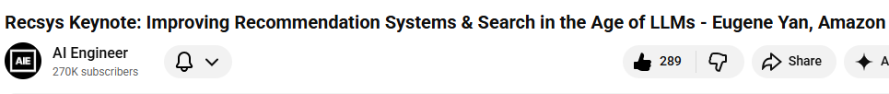
Source: https://www.youtube.com/watch?v=2vlCqD6igVA&t=635s

Slide 10
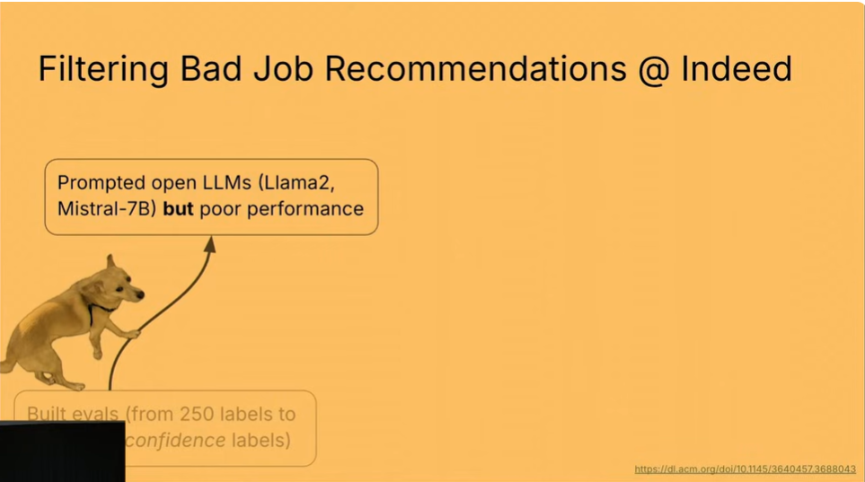
Source: https://www.youtube.com/watch?v=2vlCqD6igVA&t=635s

Slide 11
Source: https://www.youtube.com/watch?v=2vlCqD6igVA&t=635s

Slide 12
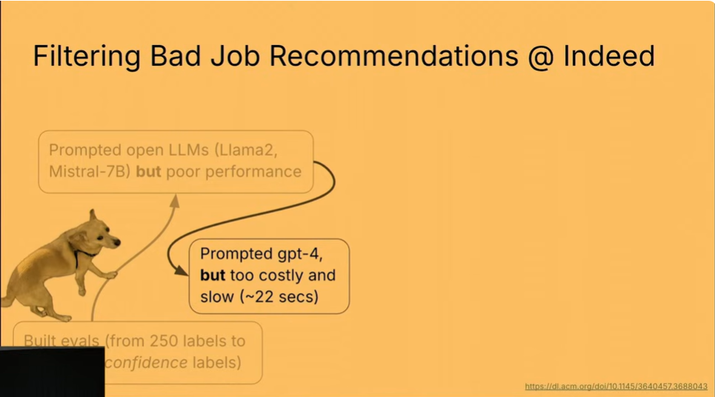
Source: https://www.youtube.com/watch?v=2vlCqD6igVA&t=635s

Slide 13
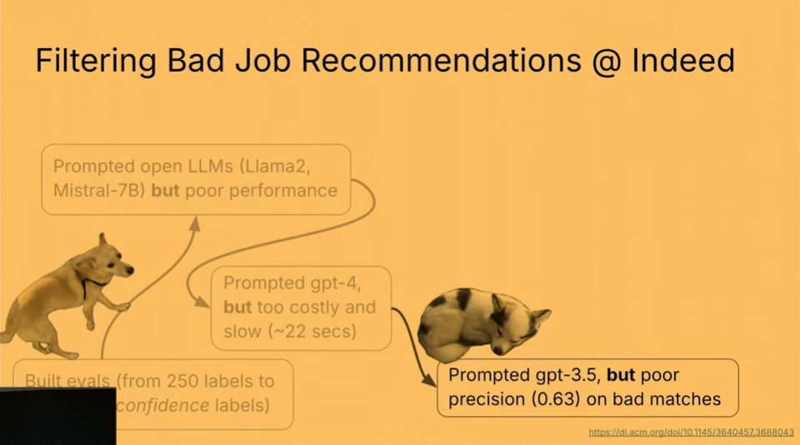
Source: https://www.youtube.com/watch?v=2vlCqD6igVA&t=635s

Slide 14
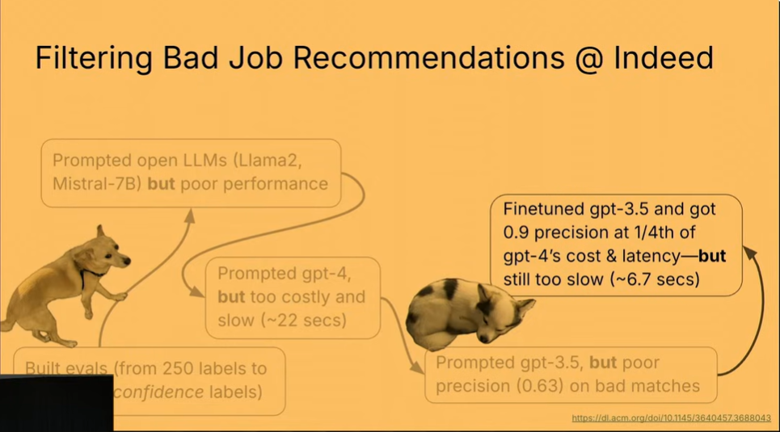
Source: https://www.youtube.com/watch?v=2vlCqD6igVA&t=635s

Slide 15
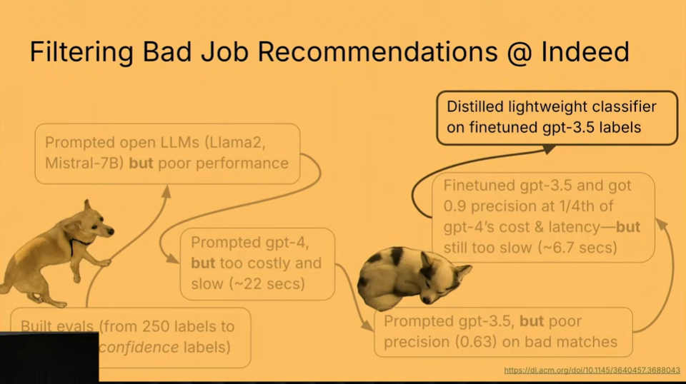
Source: https://www.youtube.com/watch?v=2vlCqD6igVA&t=635s

Slide 16
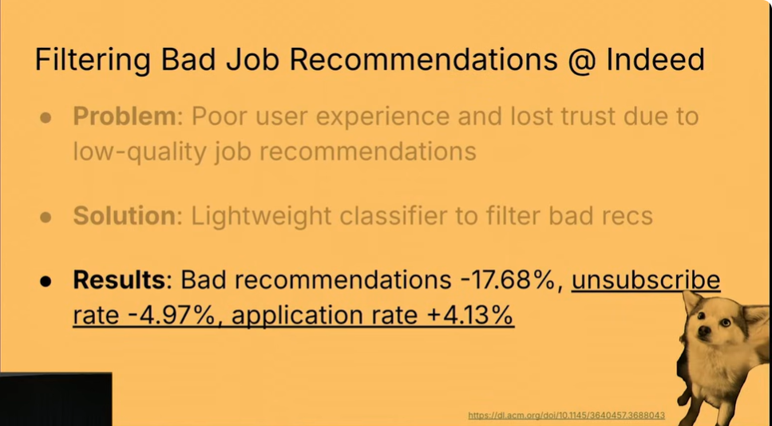
Source: https://www.youtube.com/watch?v=2vlCqD6igVA&t=635s

